Slide 1
Voltage Source
I
+
V_{S}
-
Plus sign - Anode terminal, having higher potential
Minus sign - Cathode terminal, having lower potential
Current is positive – if it flows from the anode, through the external circuit, to the cathode
Positive current flow is opposite direction to the flow of electrons

Slide 2
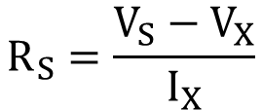
Voltage Source
R_{S}
V
V
V_{S}
I
+
V_{S}
-
+
V
-
V_{S}
V_{X}
Fig. (a)
0
I
Fig. (b)
0
I_{X}
I
Fig. (c)
Ideal constant voltage source has a V-I characteristic as shown in Fig. (a)
Ideal voltage source maintains a constant V regardless of the current drawn
V-I characteristic of a practical voltage source is as shown Fig. (b)
As the current I increases to I_{X}, voltage drops from V_{S} to V_{X} linearly
Practical voltage source is modelled as in Fig. (c)
Source output resistance
$$R_{S}=\frac{V_{S}−V_{X}}{I_{X}}$$
Determine the output resistance of a voltage source with V_{S} = 12V, V_{X} = 11.2V and $I_{X}$ = 34A

Slide 3
Current Source
I
Plus sign - Anode terminal, having higher potential
Minus sign - Cathode terminal, having lower potential
Current is positive – if it flows from the anode, through the external circuit, to the cathode
Positive current flow is opposite direction to the flow of electrons

Slide 4
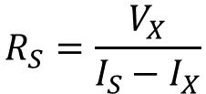
Current Source
+
V
-
I
I
I_{S}
I_{S}
I_{S}
R_{S}
I_{X}
Fig. (a)
0
V
0
V_{X}
V
Fig. (b)
Fig. (c)
Ideal constant current source has a V-I characteristic as shown in Fig. (a)
Ideal current source maintains a constant I regardless of the voltage across its terminals
V-I characteristic of a practical current source is as shown Fig. (b)
As the voltage V increases to V_{X} current drops from I_{S} to I_{X} linearly
Practical current source is modelled as in Fig. (c)
Source output resistance
$$R_{S}=\frac{V_{X}}{I_{S}−I_{X}}$$
Determine the output resistance of a current source whose output current falls from 2 A to 1.99 A when its output voltage increases from 0 to 100 V

Slide 5
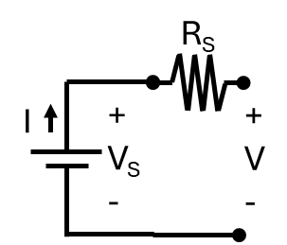
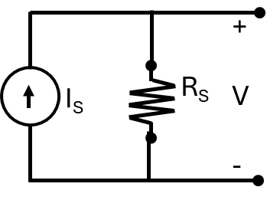
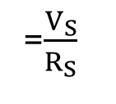
Source Transformation
=$\frac{V_{S}}{R_{S}}$
= I_{S}R_{S}

Slide 6
Equivalent Sources
+
V_{S1}
-
I
+
V_{S1} +V_{S2}
-
I₁
I₂
I₁ + I₂
+
V_{S2}
-
Voltage sources can be connected in parallel if the two sources have identical Voltages
Current sources can be connected in series if the two sources have identical Currents

Slide 7
+
V_{S}
-
+
V_{S}
-
R_{S}
Voltage source in parallel with a resistor
→ Current through resistor is determined only by the voltage source
→ Resister in the circuit may be omitted
R_{S}
I_{S}
I_{S}
Current source in series with a resistor
→ Voltage across resistor is determined only by the current source
→ Resister in the circuit may be omitted

Slide 8
Determine the equivalent circuit using Source Transformation
1A
2Ω
2A
2Ω
3A
1Ω
2Ω
1A
2Ω
4V
2A
3Ω
3A
1Ω
5A
0.75Ω
3Ω
1Ω
6V
3V
1Ω
3V
1.75Ω
0.75Ω
8V
5V

Slide 9
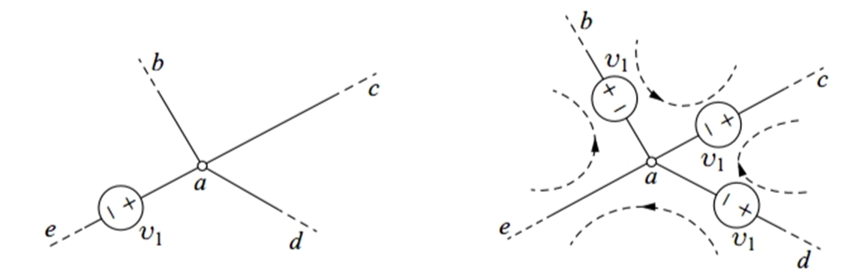
Source Shifting - Voltage Source Shifting
b
b
v₁
c
v₁
c
a
a
e
v₁
e
d
v₁
d
Fig.(a)
Fig.(b)
KVL | Fig.(a) | Fig.(b)
V_{eb}
V_{bc}
V_{dc}
V_{de}
V₁
V₁
0
-V₁ + V₁ = 0
0
-V₁ + V₁ = 0
-V₁
-V₁

Slide 10
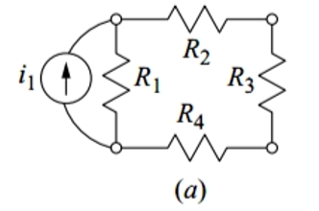
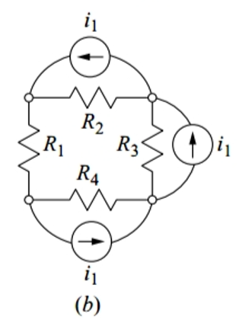
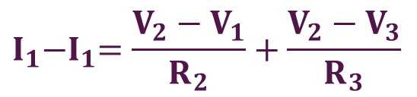
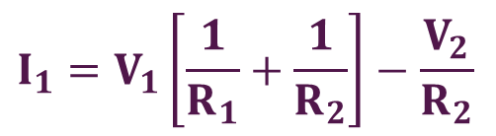
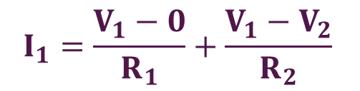
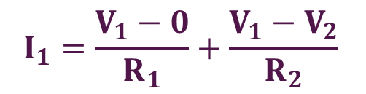
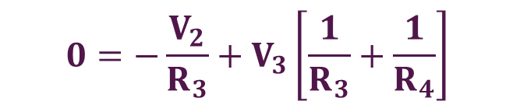
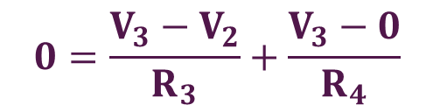
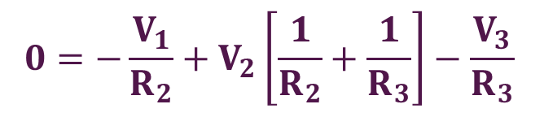
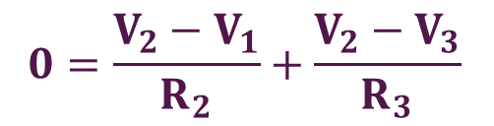
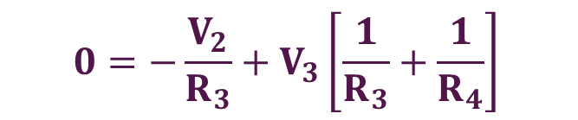
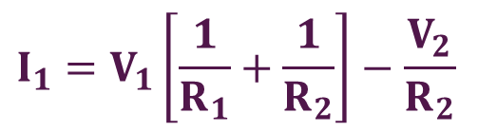
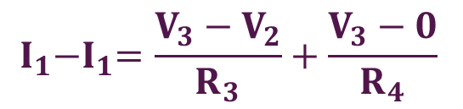
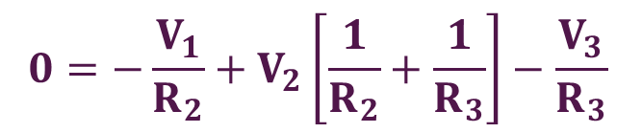
Source Shifting - Current Source Shifting
1
2
$$I_{1}=\frac{V_{1}−0}{R_{1}}+\frac{V_{1}−V_{2}}{R_{2}}$$
$$I_{1}=V_{1}\left[\frac{1}{R_{1}}+\frac{1}{R_{2}}\right]−\frac{V_{2}}{R_{2}}$$
Node 1:
→
---(1)
$$0=\frac{V_{2}−V_{1}}{R_{2}}+\frac{V_{2}−V_{3}}{R_{3}}$$
$$0={−\frac{V_{1}}{R_{2}}+V}_{2}\left[\frac{1}{R_{2}}+\frac{1}{R_{3}}\right]−\frac{V_{3}}{R_{3}}$$
Node 2:
→
---(2)
R
3
$$0=\frac{V_{3}−V_{2}}{R_{3}}+\frac{V_{3}−0}{R_{4}}$$
$$0={−\frac{V_{2}}{R_{3}}+V}_{3}\left[\frac{1}{R_{3}}+\frac{1}{R_{4}}\right]$$
Node 3:
→
---(3)
1
2
$$I_{1}=\frac{V_{1}−0}{R_{1}}+\frac{V_{1}−V_{2}}{R_{2}}$$
$$I_{1}=V_{1}\left[\frac{1}{R_{1}}+\frac{1}{R_{2}}\right]−\frac{V_{2}}{R_{2}}$$
Node 1:
→
---(1)
$$I_{1}{−I}_{1}=\frac{V_{2}−V_{1}}{R_{2}}+\frac{V_{2}−V_{3}}{R_{3}}$$
$$0={−\frac{V_{1}}{R_{2}}+V}_{2}\left[\frac{1}{R_{2}}+\frac{1}{R_{3}}\right]−\frac{V_{3}}{R_{3}}$$
Node 2:
→
---(2)
R
3
$$I_{1}{−I}_{1}=\frac{V_{3}−V_{2}}{R_{3}}+\frac{V_{3}−0}{R_{4}}$$
$$0={−\frac{V_{2}}{R_{3}}+V}_{3}\left[\frac{1}{R_{3}}+\frac{1}{R_{4}}\right]$$
Node 3:
→
---(3)

Slide 11
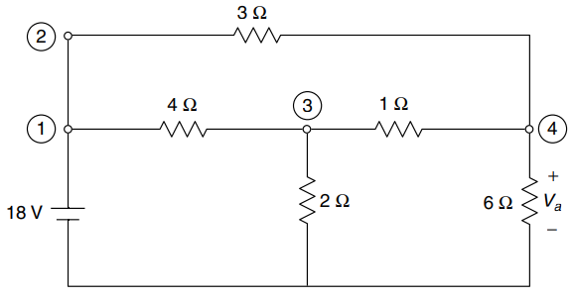
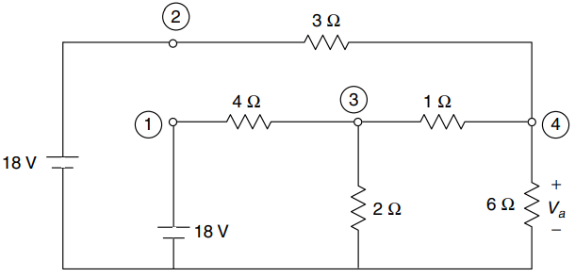
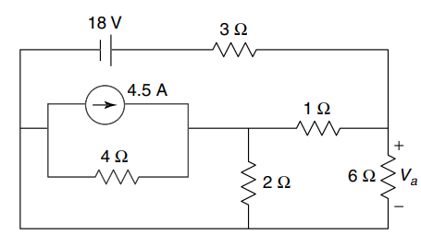
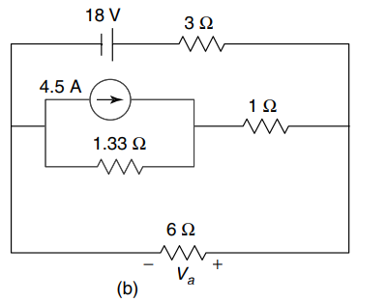
Calculate the voltage across the 6 Ω resistor using the source-shifting technique
3Ω
3Ω
4Ω
1Ω
4Ω
1Ω
+
V_{A}
-
18V
+
V_{A}
-
2Ω
6Ω
2Ω
6Ω
18V
18V
18V
18V
3Ω
3Ω
4.5A
4.5A
1Ω
1Ω
1.33Ω
4Ω
+
V_{A}
-
2Ω
6Ω
6Ω
+ V_{A} -

Slide 12
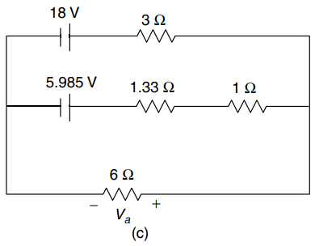
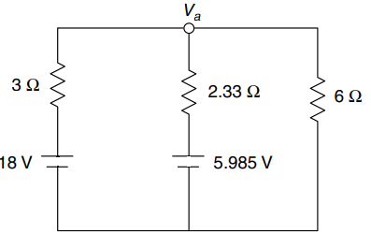


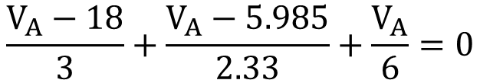

18V
3Ω
18V
3Ω
4.5A
5.985V
1Ω
1.33Ω
1Ω
1.33Ω
6Ω
6Ω
+ V_{A} -
+ V_{A} -
$$\frac{V_{A}−18}{3}+\frac{V_{A}−5.985}{2.33}+\frac{V_{A}}{6}=0$$
+
V_{A}
-
3Ω
2.33Ω
6Ω
$0.33V_{A}+0.429V_{A}+0.167V_{A}=$ 6 + 2.569
18V
5.985V
$0.926V_{A}=$ 8.569
→
$V_{A}=$ 9.254V

Slide 13
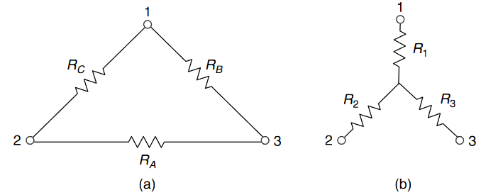
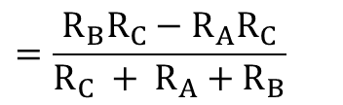
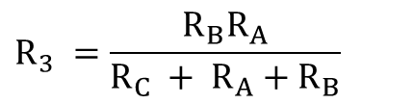
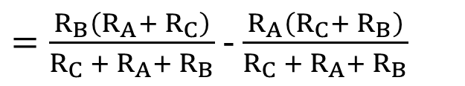
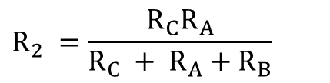
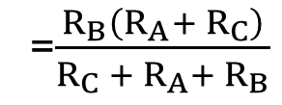
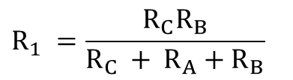
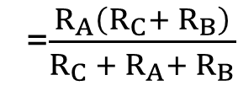
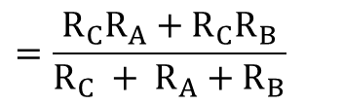
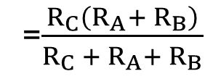
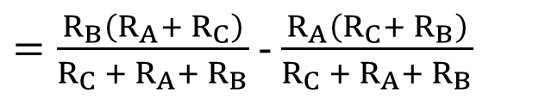
Resistance between Node 1 & 2 = R_{C} // (R_{A} + R_{B})
=$\frac{R_{C}\left(R_{A}{+ R}_{B}\right)}{R_{C} + R_{A}{+ R}_{B}}$
….(1)
R_{C}
R_{B}
Resistance between Node 2 & 3 = R_{A} // (R_{C} + R_{B})
=$\frac{R_{A}\left(R_{C}{+ R}_{B}\right)}{R_{C} + R_{A}{+ R}_{B}}$
….(2)
R_{A}
Resistance between Node 3 & 1 = R_{B} // (R_{A} + R_{C})
=$\frac{R_{B}\left(R_{A}{+ R}_{C}\right)}{R_{C} + R_{A}{+ R}_{B}}$
….(3)
Resistance between Node 1 & 2 = R₁ + R₂
….(4)
R₁
Resistance between Node 2 & 3 = R₂ + R₃
….(5)
R₂
R₃
Resistance between Node 3 & 1 = R₁ + R₃
….(6)
(6) – (5) = R₁ - R₂
$=\frac{R_{B}\left(R_{A}{+ R}_{C}\right)}{R_{C} + R_{A}{+ R}_{B}}$ - $\frac{R_{A}\left(R_{C}{+ R}_{B}\right)}{R_{C} + R_{A}{+ R}_{B}}$
$$=\frac{R_{B}R_{C}−R_{A}R_{C}}{R_{C} + R_{A}{+ R}_{B}}$$
….(7)
From (4) & (1), R₁ + R₂
$=\frac{R_{B}\left(R_{A}{+ R}_{C}\right)}{R_{C} + R_{A}{+ R}_{B}}$ - $\frac{R_{A}\left(R_{C}{+ R}_{B}\right)}{R_{C} + R_{A}{+ R}_{B}}$
$$=\frac{R_{C}R_{A}+R_{C}R_{B}}{R_{C} + R_{A}{+ R}_{B}}$$
….(8)
$$R_{1} =\frac{R_{C}R_{B}}{R_{C} + R_{A}{+ R}_{B}}$$
$$R_{2} =\frac{R_{C}R_{A}}{R_{C} + R_{A}{+ R}_{B}}$$
$$R_{3} =\frac{R_{B}R_{A}}{R_{C} + R_{A}{+ R}_{B}}$$
(7) + (8)
Similarly

Slide 14
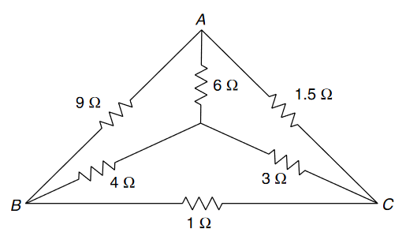
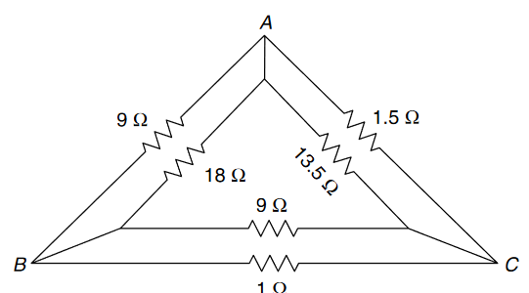
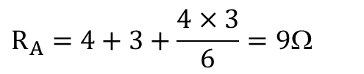
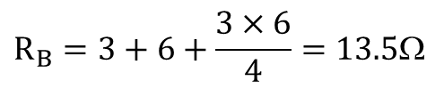
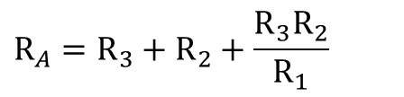
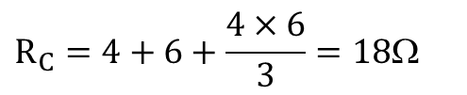
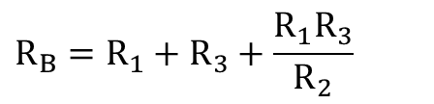
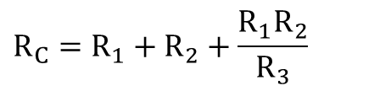
Star-Delta Transformation
$$R_{A}=R_{3}+R_{2}+\frac{R_{3}R_{2}}{R_{1}}$$
R_{C}
R_{B}
R₁
$$R_{B}=R_{1}+R_{3}+\frac{R_{1}R_{3}}{R_{2}}$$
R_{A}
R₂
R₃
$$R_{C}=R_{1}+R_{2}+\frac{R_{1}R_{2}}{R_{3}}$$
Find an equivalent resistance between A and B in the network
$$R_{A}=4+3+\frac{4×3}{6}=9Ω$$
$$R_{B}=3+6+\frac{3×6}{4}=13.5Ω$$
R_{B}
$$R_{C}=4+6+\frac{4×6}{3}=18Ω$$
R_{C}
R_{A}

Slide 15
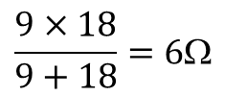

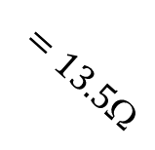
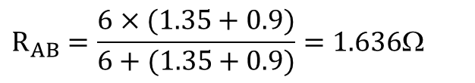
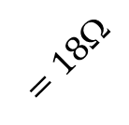


$$\frac{9×18}{9+18}=6Ω$$
$$\frac{1.5×13.5}{1.5+13.5}=1.35Ω$$
$$=18$$
R_{B}
R_{C}
$$=13.5$$
$$R_{AB}=\frac{6×(1.35+0.9)}{6+(1.35+0.9)}=1.636Ω$$
R_{A}
$$=9$$
$$\frac{9×1}{9+1}=0.9Ω$$

Slide 16






















Find an equivalent resistance between A and B in the network
$$10$$
$$R1$$
$$R2$$
$$30$$
$$15$$
$$R3$$
$$2$$
$$30$$
$$12.5$$
$$R_{1} =\frac{R_{C}R_{B}}{R_{C} + R_{A}{+ R}_{B}}$$
$$=\frac{5×20}{5+20+15}=2.5Ω$$
$$37.5$$
$$15$$
$$3.875$$
$$30$$
$$R_{2} =\frac{R_{C}R_{A}}{R_{C} + R_{A}{+ R}_{B}}$$
$$=\frac{15×20}{5+20+15}=7.5Ω$$
$$R_{3} =\frac{R_{B}R_{A}}{R_{C} + R_{A}{+ R}_{B}}$$
$$=\frac{5×15}{5+20+15}=1.875Ω$$

Slide 17





















$$12.5$$
$$12.5$$
$$37.5$$
$$R1$$
$$3.875$$
$$2.04$$
$$R2$$
$$15$$
$$30$$
$$15$$
$$1.63$$
$$15.76$$
$$R3$$
$$R_{1} =\frac{R_{C}R_{B}}{R_{C} + R_{A}{+ R}_{B}}$$
$$=\frac{3.875×37.5}{3.875+37.5+30}=2.04Ω$$
$$R_{2} =\frac{R_{C}R_{A}}{R_{C} + R_{A}{+ R}_{B}}$$
$$=\frac{3.875×30}{3.875+37.5+30}=1.63Ω$$
$$R_{AB}=\frac{(12.5+2.04)×(15+1.63)}{(12.5+2.04+15+1.63)}+15.76=23.52Ω$$
$$R_{3} =\frac{R_{B}R_{A}}{R_{C} + R_{A}{+ R}_{B}}$$
$$=\frac{30×37.5}{3.875+37.5+30}=15.76Ω$$

Slide 18














Find an equivalent resistance between A and B in the network
$$R_{1}=5+4+\frac{5×4}{3}=15.67Ω$$
$$R_{3}=5+3+\frac{5×3}{4}=11.75Ω$$
$$RAB=\frac{9.78×6.17}{9.78+6.17}=3.78Ω$$
$$R_{2}=4+3+\frac{4×3}{5}=9.4Ω$$
$$\frac{13×11.75}{13+11.75}=6.17Ω$$
$$R_{4}=6+8+\frac{6×8}{4}=26Ω$$
$$\frac{26×15.67}{26+15.67}$$
$$=9.78$$
$$R_{5}=8+4+\frac{8×4}{6}=17.33Ω$$
$$0$$
$$R_{6}=6+4+\frac{6×4}{8}=13Ω$$

Slide 19


Nodal Analysis
Few Assumptions:
Point under consideration is assumed to be at higher potential when compared to other nodes
While writing the node equation, current leaving (entering) the node will have positive (negative) sign on LHS
Node V₁
$I_{1}+\frac{V_{1}−0}{R_{2}}$ $+\frac{V_{1}−V_{2}}{R_{4}}$ $+\frac{V_{1}−V_{2}}{R_{3}}=0$
Node V₂
${−I}_{2}+\frac{V_{2}−V_{1}}{R_{4}}$ $+\frac{V_{2}−V_{1}}{R_{3}}=0$

Slide 20
Nodal Analysis
Few Assumptions:
Point under consideration is assumed to be at higher potential when compared to other nodes
While writing the node equation, current leaving (entering) the node will have positive (negative) sign on LHS
Node V₁
$I_{1}+\frac{V_{1}−0}{R_{2}}$ $+\frac{V_{1}−V_{2}}{R_{4}}$ $+\frac{V_{1}−V_{2}}{R_{3}}=0$
Node V₂
${−I}_{2}+\frac{V_{2}−V_{1}}{R_{4}}$ $+\frac{V_{2}−V_{1}}{R_{3}}=0$

Slide 21


























Node A
$15mA+\frac{V_{A}−0}{2kΩ}$ $+\frac{V_{A}−0}{8kΩ}=0$
$$B$$
$$→$$
$$15mA$$
$−15mA+\frac{V_{B}−0}{8kΩ}$ $+\frac{V_{B}−0}{2kΩ}=0$
Node B
$$→$$
$$I1$$
$$A$$
$$→$$
$$→$$
$$→$$
$$I4$$
$$I2$$
$$I3$$
$$8k$$
$$2k$$
$$8k$$
$$2k$$
Node A
$$15mA+0.5mV_{A}+0.125mV_{A}=0$$
→
$$V_{A}=−24V$$
$I1=\frac{V_{B}−0}{8kΩ}$ $=\frac{24−0}{8kΩ}$ = 3mA
Node B
$$−15mA+0.125mV_{B}+0.5mV_{B}=0$$
$I2=\frac{V_{A}−0}{2kΩ}$ $=\frac{−24−0}{2kΩ}$ = -12mA
$$V_{B}=24V$$
→
$I1+I4=3mA+12mA$ $=$ 15mA
$I3=\frac{V_{A}−0}{8kΩ}$ $=\frac{−24−0}{8kΩ}$ = -3mA
$I2+I3=−12mA−3mA$ $=$ -15mA
$I4=\frac{V_{B}−0}{2kΩ}$ $=\frac{24−0}{2kΩ}$ = 12mA

Slide 22










Node V₁
$−4mA+\frac{V_{1}−0}{6kΩ}$ $+\frac{V_{1}−V_{2}}{12kΩ}=0$
$$V1$$
$$12k$$
$V$₂
$$4mA$$
$$6k$$
$$6k$$
$$2mA$$
$2mA+\frac{V_{2}−0}{6kΩ}$ $+\frac{V_{2}−V_{1}}{12kΩ}=0$
Node V₂
Node V₁
$$−4mA+0.17mV_{1}+0.08mV_{1}−{0.08V}_{2}=0$$
$$−4mA+0.25mV_{1}−{0.08V}_{2}=0$$
Node V₂
$2mA+0.17{mV}_{2}$ $+ 0.08{mV}_{2}−{0.08mV}_{1}=0$
$$2mA−0.08mV_{1}−{0.25V}_{2}=0$$

Slide 23














$V$₁
$$10k$$
$V$₂
$−4mA+\frac{V_{1}−0}{10kΩ}$ $+\frac{V_{1}−V_{2}}{10kΩ}=0$
Node V₁
---(1)
$$10k$$
$$4mA$$
$2I$₀
$$10k$$
$I$₀
$2I0+\frac{V_{2}−0}{10kΩ}$ $+\frac{V_{2}−V_{1}}{10kΩ}=0$
Node V₂
---(2)
$$I0=\frac{V_{1}−0}{10kΩ}$$
$2\frac{V_{1}−0}{10kΩ}+\frac{V_{2}−0}{10kΩ}$ $+\frac{V_{2}−V_{1}}{10kΩ}=0$
Also,
---(3)
---(4)
Using (3) in (2)
Equation (1)→
$−4mA+0.1mV_{1}$ +$0.1mV_{1}−0.1mV_{2}=0$
Equation (4)→
$0.2mV_{1}$ +$0.1mV_{2} \text{+}0.1mV_{2}−0.1mV_{1}=0$

Slide 24










Determine V₀
Node V₁
$−2mA+\frac{V_{1}−0}{3kΩ}$ $+\frac{V_{1}}{6k}=0$
---(1)
$$\frac{V_{1}}{6000}$$
$V$₁
Node V₀
$−\frac{V_{1}}{6k}+\frac{V_{0}−0}{12kΩ}$ $+\frac{V_{0}−0}{12kΩ}=0$
---(2)
$$+$$
$V$₀
-
$$2mA$$
$$3k$$
$$12k$$
$$12k$$
Equation (1)→
$$−2mA+0.33{mV}_{1}+0.17mV_{1}=0$$
Equation (2)→
$$−0.17mV_{1}+0.08mV_{0}+0.08mV_{0}=0$$

Slide 25




















$$9k$$
$\frac{V_{2}−V_{1}}{12kΩ}$ $+\frac{V_{2}−V_{3}}{12kΩ}+\frac{V_{2}−0}{6k}=0$
Node V₂
$$12k$$
$V$₂
$$12k$$
$V$₁
$V$₃
We have: V₁ = 12V & V₃ = -6V
$$R_{1}$$
$$R_{2}$$
$$12V$$
$$6k$$
$6$V
$0.08mV_{2}−1m$ $+0.08mV_{2}+0.5m+0.17V_{2}=0$
$0.33mV_{2}−0.5m$ $=0$
$$→ V_{2}=1.52V$$
$=\frac{V_{1}−V_{2}}{12kΩ}$ $=\frac{12−1.52}{12kΩ}=0.87mA$
I_{R1}
$=\frac{V_{1}−V_{3}}{9kΩ}$ $=\frac{12−(−6)}{9kΩ}=2mA$
I_{9kΩ}
$=\frac{V_{2}−V_{3}}{12kΩ}$ $=\frac{1.52−(−6)}{12kΩ}=0.63mA$
I_{R2}
I_{12V}
$=\text{I}\text{R}\text{1}+\text{I}\text{9}\text{k}$ $=0.87mA+2mA=2.87mA$
I_{6kΩ}
$=\frac{V_{2}−0}{6kΩ}$ $=\frac{1.52−0}{6kΩ}=0.25mA$
I_{6V}
$=\text{I}\text{R}\text{2}+\text{I}\text{9}\text{k}$ $=0.63mA+2mA=2.63mA$

Slide 26
















Current through 6V battery
= (I₂$+4mA)$
---(1)
Called Super Node
$$6V$$
$$=\left(\frac{V_{2}−0}{12kΩ}+4mA\right)$$
V$1$
V$2$
---(2)
$$6mA$$
$$12k$$
$$4mA$$
$$−6mA+\frac{V_{1}−0}{6k}+\text{(}\text{I}\text{2}+4mA)=0$$
$$6k$$
Node V₁
---(3)
$I$₁
I$2$
$$−6mA+\frac{V_{1}−0}{6k}+\text{(}\frac{V_{2}−0}{12kΩ}+4mA)=0$$
Using (2) in (3),
---(4)
$$4mA+\frac{V_{2}−0}{12k}+\text{(}I_{1}−6mA)=0$$
Node V₂
---(5)
Solve (4) and (6) for V₁ and V₂
$$4mA+\frac{V_{2}−0}{12k}+\text{(}\frac{V_{1}−0}{6kΩ}−6mA)=0$$
---(6)

Slide 27




Determine I₀
V₃ = 6V, V_{x} = V₂,
2V_{x} = V₁ – V₂
2V_{x} = V₁ – V_{x}
2V₂ = V₁ – V₂ → V₁ = 3V₂
---(1)
$$\frac{V_{1}−V_{3}}{6kΩ}+\frac{V_{1}−0}{12kΩ}+\frac{V_{2}−0}{6kΩ}+\frac{V_{2}−V_{3}}{12kΩ}=0$$
Node V₁,
---(2)
---(3)
Using V₃=6V in (3),
$$2\left(V_{1}−V_{3}\right)+V_{1}+{2V}_{2}+V_{2}−V_{3}=0$$
---(4)
$$3V_{1}+−18+{3V}_{2}=0$$
Using (1) in (4),
$3V_{1}+V_{1}=18$ → $V_{1}=\frac{18}{4}$V
$I_{0}=\frac{V_{1}−0}{12kΩ}=\frac{\frac{18}{4}}{12kΩ}$= $\frac{3}{8}mA$

Slide 28


$$V_{1}$$
$$L$$
$$V_{2}$$
$$V_{1}$$
$$C$$
$$V_{2}$$
$$V_{1}$$
$$R$$
$$V_{2}$$
$$I$$
$$I$$
$$I$$
($V_{1}−V_{2}$) = IR
($V_{1}−V_{2}$) = L$\frac{dI}{dt}$
$\text{(}V_{1}−V_{2}\text{)}$= $\frac{1}{C}\int{I}dt$
I = $\frac{\text{(}V_{1}−V_{2}\text{)}}{R}$
I= $\frac{1}{L}\int{\text{(}V_{1}−V_{2}\text{)}}dt$
I = C$\frac{\text{(}V_{1}−V_{2}\text{)}}{dt}$

Slide 29

Write Loop equation
If the travel is from – to +, it is taken as negative on LHS
If the current through a component is the difference between two loop currents (say i₁−i₂), then the direction of the net current will be direction of first current
Loop 1,
$i_{1}R_{1}$+ $L_{1}\frac{di_{1}}{dt}$+ $\frac{1}{C_{1}}\int{i_{1}}dt$ ${+R}_{2}\text{(}i_{1}−i_{2}\text{)}+L_{2}\frac{d\text{(}i_{1}−i_{2}\text{)}}{dt}$+$\frac{1}{C_{2}}\int{\text{(}i_{1}−i_{2}\text{)}}dt$ ${−V}_{a}$= 0
Loop 2,
$i_{2}R_{3}$+ $L_{3}\frac{di_{2}}{dt}$+ $\frac{1}{C_{3}}\int{i_{2}}dt$ ${{+V}_{b}+\frac{1}{C_{2}}\int{\text{(}i_{2}−i_{1}\text{)}}dt+L_{2}\frac{d\text{(}i_{2}−i_{1}\text{)}}{dt}+R}_{2}\text{(}i_{2}−i_{1}\text{)}$ = 0

Slide 30

Determine the current through the 2Ω resistor
Loop I₁,
$${6I}_{1}+1\text{(}I_{1}−I_{2}\text{)}−\text{1}0=0$$
→
$${7I}_{1}−I_{2}=\text{1}0$$
---(1)
eter
I₁
I₂
I₃
Loop I₂
$${2I}_{2}+3\text{(}I_{2}−I_{3}\text{)}+1\text{(}I_{2}−I_{1}\text{)}=0$$
→
$${−I}_{1}+6I_{2}−3I_{3}=0$$
$$\left[\begin{matrix}7 & −1 & 0 \\ −1 & 6 & −3 \\ 0 & −3 & 13\end{matrix}\right]$$
$$\left[\begin{matrix}I_{1} \\ I_{2} \\ I_{3}\end{matrix}\right]$$
$$\left[\begin{matrix}10 \\ 0 \\ −20\end{matrix}\right]$$
---(2)
=
Loop I₃
$${10I}_{3}+20+3\text{(}I_{3}−I_{2}\text{)}=0$$
$$I_{1}=1.34A$$
$${−3I}_{2}+13I_{3}=−20$$
→
---(3)
→
$I_{2}=−0.62$A
$I_{3}=$-1.68A

Slide 31

Solve for the current supplied by the battery
Loop I₁,
$${3I}_{1}+1\text{(}I_{1}−I_{2}\text{)}\text{+4}\text{(}I_{1}−I_{3}\text{)}−\text{4}=0$$
→
$${8I}_{1}−I_{2}−4I_{3}=\text{4}$$
---(1)
Loop I₂
$${2I}_{2}+5\text{(}I_{2}−I_{3}\text{)}+1\text{(}I_{2}−I_{1}\text{)}=0$$
→
$${−I}_{1}+8I_{2}−5I_{3}=0$$
---(2)
$$\left[\begin{matrix}8 & −1 & −4 \\ −1 & 8 & −5 \\ −4 & −5 & 15\end{matrix}\right]$$
$$\left[\begin{matrix}I_{1} \\ I_{2} \\ I_{3}\end{matrix}\right]$$
$$\left[\begin{matrix}4 \\ 0 \\ 0\end{matrix}\right]$$
=
Loop I₃
$${6I}_{3}+4\text{(}I_{3}−I_{1}\text{)}+5\text{(}I_{3}−I_{2}\text{)}=0$$
$I_{1}=$0.66A
→
$${−4I}_{1}−5I_{2}+15I_{3}=0$$
---(3)
→
$$I_{2}=0.24A$$
$$I_{3}=0.26A$$

Slide 32

Obtain the branch currents
$$\text{(}I_{A}−I_{B}\text{)}$$
Loop I_{A},
$${5I}_{A}+10I_{B}+10\text{(}I_{A}−I_{B}\text{)}\text{+5}I_{A}−\text{5}=0$$
From (1),
$$I_{A}=0.2\text{5}\text{A}$$
→
$${20I}_{A}+0I_{B}=\text{5}$$
---(1)
Loop I_{B},
$${5I}_{B}+10−5I_{A}−10\text{(}I_{A}−I_{B}\text{)}=0$$
Using IA in (2),
$$I_{B}=−0.42\text{A}$$
$${−15I}_{A}−15I_{B}=−10$$
→
---(2)

Slide 33

Power loss in R_{L} = 18W. Solve for V₀ and power supplied by it.
$$V_{1}$$
$$V_{2}$$
$$I_{R_{L}}$$
$I_{R_{L}}^{2}×R_{L}$= 18 → $I_{R_{L}}$ = 3A
Node V₁,
$\frac{V_{1}−V_{0}}{5}$ $+\frac{V_{1}−0}{2}$ $+\frac{V_{1}−0}{4}=0$
$V_{2}=I_{R_{L}}(5+2)$ = 21V
${0.2V}_{1}−0.2V_{0}$ $+0.75V_{1}=0→{0.95V}_{1}−0.2V_{0}=0$
---(1)
Node V₂,
$−2V_{X}+\frac{V_{2}−0}{2}$ $+I_{R_{L}}=0$
$$V_{X}=V_{0}−V_{1}$$
$$\left[\begin{matrix}0.95 & −0.2 \\ 2 & −2\end{matrix}\right]$$
$$\left[\begin{matrix}V_{1} \\ V_{0}\end{matrix}\right]=\left[\begin{matrix}0 \\ −13.5\end{matrix}\right]$$
$−2(V_{0}−V_{1})$ $+\frac{21}{2}+3=0→{2V}_{1}−2V_{0}=−\frac{27}{2}$
---(2)
$I_{V_{0}}=$ $\frac{V_{0}−V_{1}}{5}$
$=$ $\frac{8.55−1.8}{5}$ $=$1.35A
Power supplied by V₀ $=\text{V}\text{0}{×I}_{V_{0}}$
$$=\text{V}\text{0}{×I}_{V_{0}}=\text{8.55}×1.35$$
$=$ 11.54W
$$V_{1}=1.8V$$
→
$$V_{0}=8.55V$$

Slide 34

Determine voltage between points x and y
Loop I₁,
$${−\text{2+}3I}_{1}+2I_{1}=0$$
$$I_{1}=0.4A$$
→
---(1)
$$V_{XY}=−3I_{1}−4+3I_{2}$$
$$V_{XY}=−3×0.4−4+3×0.5$$
$$=−3.7V$$
Loop I₂
$${3I}_{2}+5I_{2}−\text{4}=0$$
→
→
$$I_{2}=0.5A$$
---(2)

Slide 35

Determine the power delivered by the voltage source and the current in the 10Ω resistor
$$I_{1}−I_{2}=3A$$
$I_{3}=10$A
→
$$I_{1}=3+I_{2}$$
Loop equation
$${5I}_{1}+5I_{2}+10\text{(}I_{2}−I_{3}\text{)}\text{+1}\text{(}I_{1}−I_{3}\text{)}−\text{50}=0$$
→
$${6I}_{1}+15I_{2}−{11I}_{3}=\text{50}$$
→
$$6(3+I_{2})+15I_{2}−11×10=\text{50}$$
→
$I_{2}=\text{6.76}$A
→
$I_{1}=3+I_{2}=\text{9.76}$A
Current in the 10Ω resistor $=\text{(}I_{2}−I_{3}\text{)}\text{ = −3.24}\text{A}$
Power delivered by the voltage source $=\text{50}×I_{1}$
$$=\text{50}×9.76 \text{= }488W$$

Slide 36

Determine the current in the 3Ω resistor
$$I_{1}−I_{3}=7A$$
→
$$I_{1}=7+I_{3}$$
$$1$$
Loop 1 →2 to 3 to 1 to 2
→
$${2I}_{2}+3\text{(}I_{2}−I_{3}\text{)}\text{+1}\text{(}I_{2}−I_{1}\text{)}=0$$
→
$${2I}_{2}+3\text{(}I_{2}−I_{3}\text{)}\text{+1}\text{(}I_{2}−(7+I_{3})\text{)}=0$$
$$2$$
→
$${6I}_{2}−4I_{3}=7$$
Loop 2 →7V to 1 to 3 to 1 to 7V
→
$I_{2}=2.5$A
$$I_{3}=2A$$
$$I_{1}=7+ I_{3}=9A$$
→
$$−7+\text{1}\text{(}I_{1}−I_{2}\text{)}\text{+3}\text{(}I_{3}−I_{2}\text{)}\text{+1}I_{3}=0$$
Current in the 3Ω resistor
$=$ $\text{(}I_{3}−I_{2}\text{)}$
$=$ $\text{(}2−2.5\text{)}\text{ =}−\text{0.5}\text{A}$
→
$$−7+\text{1}\text{(}(7+I_{3})−I_{2}\text{)}\text{+3}\text{(}I_{3}−I_{2}\text{)}\text{+1}I_{3}=0$$
→
$${−4I}_{2}+5I_{3}=0$$

Slide 37
Superposition Theorem:
In a linear network containing multiple sources, the total response is the algebraic sum of response due to individual sources
Note:
Replace independent voltage sources by internal resistance
    Short circuit in case of ideal voltage source (Since R_{S} = 0)
    Open circuit in case of ideal current (Since R_{S} = ∞)
A dependent source has zero value only when its control voltage or current is zero

Slide 38

Determine the current through 2Ω resistor using Superposition theorem

Slide 39

$$I21$$
$$\frac{10×2}{10+2}=1.67Ω$$
I $= \frac{40}{5+1.67}=6.0A$
$$5+1.67$$
$$=6.67$$
$$I$$
$$I2Ω1=I× \frac{10}{10+2}=5.0A$$
$$1.67$$

Slide 40
$$\frac{10×2}{10+2}=1.67Ω$$
$$I22$$
I $= \frac{0−20}{5+1.67}=−3.0A$
$$I$$
$$1.67$$
$$I2Ω2=I×\frac{10}{10+2}=−2.5A$$

Slide 41
$$I=\frac{10}{3.33+2}=1.88A$$
$$I23$$
$$I23=I=1.88A$$
$$\frac{10×5}{10+5}=3.33Ω$$
$$I2=I21+I22+I23$$
$=5.0−2.5+1.88$
$=4.38A$
$$I$$
$$3.33$$

Slide 42

Determine the current through 10Ω resistor using Superposition theorem

Slide 43
Determine the current through 10Ω resistor using Superposition theorem

Slide 44
Determine the current through 10Ω resistor using Superposition theorem
$$2+5=7$$
$$\frac{10×7}{10+7}=4.12Ω$$
$$I$$
$I10$₁
$$I=\frac{10}{1+4.12}=1.95A$$
$$I10Ω1=I×\frac{7}{10+7}=0.8A$$

Slide 45
$$I=4×\frac{5}{5+2.91}=2.52A$$
$$I$$
$I10$₂
$$I10Ω2=I×\frac{1}{10+1}=0.23A$$
$$\frac{10×1}{10+1}=0.91Ω$$
$$I10=I101+I102=0.8+0.23=1.03A$$
$$2+0.91=2.91$$

Slide 46

Determine the current through 6Ω resistor using Superposition theorem

Slide 47
Determine the current through 6Ω resistor using Superposition theorem
$$I=\frac{15−V1}{6}$$
$$V1$$
$$\frac{V1−15}{6}−3I+\frac{V1−0}{8}=0$$
$$\frac{V1−15}{6}−3\frac{15−V1}{6}+\frac{V1−0}{8}=0$$
$$0.17V1−2.5−7.5+0.5V1+0.125V1=0$$
$0.795V1=10$ → $V1=12.58V$
$I6Ω1=I=\frac{15−V1}{6}$ $=\frac{15−12.58}{6}$ $=0.4A$

Slide 48
Determine the current through 6Ω resistor using Superposition theorem
$$I=\frac{0−V1}{6}$$
$$V1$$
$$\frac{V1−0}{6}−3I+\frac{V1−(−10)}{8}=0$$
$$\frac{V1−0}{6}−3\frac{0−V1}{6}+\frac{V1+10}{8}=0$$
$$0.17V1+0.5V1+0.125V1+1.25=0$$
$0.795V1=−1.25$ → $V1=−1.57V$
$I6Ω2=I=\frac{0−V1}{6}=\frac{0−(−1.57)}{6}$ $=0.26A$
$$I6=I61+I62=0.4+0.26=0.66A$$

Slide 49


Determine the current through R_{L}, when R_{L} is increased from 100Ω to 1kΩ with a step of 200Ω
100Ω
100Ω
Solving using KVL/KCL/Super Position theorem is too cumbersome
10V
100Ω
R_{L}
$$I_{R_{L}}=\frac{VTh−0}{RTh+RL}$$
R_{L}
It is compact and easier to solve

Slide 50
Thevenin’s Theorem
Any two-terminal Linear electrical network consisting of resistances and independent sources (voltage or current or both) can be replaced by an equivalent voltage source (V_{Th}) in series with an equivalent resistance (R_{Th})
Finding V_{Th}:
Open circuit the terminals across which we need to find V_{Th}
For the remaining circuit, determine the voltage across the open terminals (V_{Th})
Finding R_{Th}:
Replace all the independent Voltage/Current sources by their internal resistance
Look backward into the resulting circuit from the open terminals and calculate the resistance (R_{Th})
2-terminal
Linear electrical network
X
Y
R_{Th}
X
Y
+
V_{Th}
-

Slide 51
Determine the current through R_{L}, when R_{L} is increased from 100Ω to 1kΩ with a step of 200Ω
No current through this resistor
100Ω
100Ω
100Ω
100Ω
+
V_{Th}
-
10V
100Ω
R_{L}
10V
100Ω
R_{L}
100Ω
100Ω
+
V_{Th}
-
$V_{Th}=\frac{10−0}{100+100}×100=$5V
10V
100Ω
R_{L}

Slide 52
Determine the current through R_{L}, when R_{L} is increased from 100Ω to 1kΩ with a step of 200 Ω
100Ω
100Ω
10V
100Ω
R_{L}
100Ω
100Ω
R_{Th}
10V
100Ω
R_{L}
$R_{Th}=100+\frac{100×100}{100+100}=$150Ω
R_{L}(Ω) | $I_{R_{L}}$(A)
100 | 0.02
300 | 0.01
500 | 7.69×10⁻³
700 | 5.88×10⁻³
900 | 4.76×10⁻³
1100 | 4.00×10⁻³
$$=150$$
$$I_{R_{L}}=\frac{VTh−0}{RTh+RL}$$
$$=5V$$
R_{L}

Slide 53

Determine the current through 2Ω resistor using Thevenin's Theorem
+V_{Th}-
$$I$$
$$5I+20+10I−40=0$$
→ 1$5I=20\text{→}$ $I=1.33A$
R_{Th}
V_{Th} $−$ 10 $−10I=0$
$\text{→}$V_{Th} $=$ 10 $+ 10I=23.3V$
$$=3.33$$
$I_{2\text{Ω}}=\frac{\text{V}\text{Th}}{\text{R}\text{Th}+2}=4.37$mA
$R_{Th}=\frac{5×10}{5+10}=3.33$Ω
$$=23.3V$$
2Ω

Slide 54

Determine the current through terminals A & B
V₁
V₂
+
V_{Th}
-
Node V₁
$$\frac{V1−2}{2}+\frac{V1−0}{12}+\frac{V1−V2}{1}=0$$
$$0.5V1−1+0.08V+V1−V2=0$$
$1.58V1−V2=0.92$ ---(1)
R_{Th}
Node V₂
$$\frac{V2−V1}{1}+\frac{V2−4}{3}=0$$
$\frac{2×12}{2+12}=1.71$Ω
$−V1+1.33V2=1.33$---(2)
$1.71+1=2.71$Ω
$$I_{2\text{Ω}}=\frac{\text{V}\text{Th}}{\text{R}\text{Th}+2}$$
$$=0.8A$$
$R_{Th}=\frac{3×2.71}{3+2.71}=1.42$Ω
$$Solving \left(1\right) \& \left(2\right), V1=2.32V, V2=2.74V$$
$$→VTh=V2=2.74V$$

Slide 55

Obtain Thevenin's equivalent across terminals A & B
I₁$= \frac{8−VTh}{4}$
+
V_{Th}
-
$$\frac{VTh−8}{4}−2I1=0$$
$$\frac{VTh−8}{4}−2×\frac{8−VTh}{4}=0$$
$$0.25VTh−2−4+0.5VTh=0$$
I₁$= \frac{0−V}{4}$
I
$$→ VTh=8V$$
+
V
-
$−$I₁ $−$2I₁$−$I $=0$
$$=1.33$$
3I₁ $=$I=3× $\frac{0−V}{4}$
R_{Th}
R_{Th}$= \frac{V}{I}=\frac{4}{3}\text{Ω}$ $=1.33\text{Ω}$
$$=8V$$

Slide 56

Obtain Thevenin's equivalent across terminals A & B
Loop 1
$$I1+I1+aV1−V1=0$$
bI₁
I₁$= \frac{V1−aV1}{2}$
1Ω
A B
I₁
$$+VTh−$$
Loop 2
1Ω
1Ω
Loop 2
$$VTh−aV1−1I1−bI1=0$$
I = 0
R_{L}
Loop 1
V₁
aV₁
$$VTh=aV1+I1(1+b)$$
$$VTh=aV1+\frac{V1−aV1}{2}(1+b)$$
$$VTh=\frac{V1}{2}(1+a+b−ab)$$

Slide 57
Obtain Thevenin's equivalent across terminals A & B
R_{Th}
1$I+bI1+0.5I+IRL−V=0$
bI₁
1Ω
I
A B
$$(1.5+RL)I+bI1=V$$
I₁
$$+V−$$
1Ω
1Ω
I₁$=−\frac{I×1}{1+1}$ $=−0.5I$
Also,
R_{L}
aV₁
$$(1.5+RL)I+b(−0.5I)=V$$
$\frac{1×1}{1+1}=0.5$Ω
R_{Th}$=\frac{V}{I}$ $=1.5+RL−0.5b$

Slide 58


Obtain Thevenin's equivalent across terminals A & B
V_{A}
R₂
A
$$+$$
$$V$$
$$−$$
I
R₂
$$−VTh+\text{β(}\text{V}\text{1}−\text{V}\text{A}\text{)}=0$$
R₁
V_{A}
A
+
V_{Th}
-
R₁
Also,
$$\text{V}\text{A}=VTh$$
β(0$−$V_{A})
+
V₁
-
I=0
$$−VTh+\text{β(}\text{V}\text{1}−\text{V}\text{Th}\text{)}=0$$
R_{Th}
B
β(V₁$−$V_{A})
$$VTh=\frac{\text{β}V1}{1+\text{β}}$$
B
$$I=\frac{V−\text{(}−\text{β}\text{VA}\text{)} }{R2+R1}$$
$$→VA=\frac{I\text{R}\text{1} }{1+β}$$
Also,
$$\text{V}\text{A}=IR1+(−\text{β}\text{VA})$$
$$I=\frac{V\text{+}\text{β}\frac{I\text{R}\text{1} }{1+β}}{R2+R1}$$
$$→RTh=\frac{V}{I}=R2+R1(\frac{1 }{1+β})$$

Slide 59
Norton’s Theorem
Any two-terminal Linear electrical network consisting of resistances and independent sources (voltage or current or both) can be replaced by an equivalent current source (I_{Nort}) in series with an equivalent resistance (R_{Nort})
Finding I_{Nort} :
Short circuit the terminals through which we need to find I_{Nort}
For the remaining circuit, determine the current through the shorted terminals (I_{Nort})
Finding R_{Nort} :
Replace all the independent Voltage/Current sources by their internal resistance
Look backward into the resulting circuit from the open terminals and calculate the resistance (R_{Nort}) Note: R_{Nort} = R_{Th}
2-terminal Linear electrical network
X
Y
+
V
-
I_{Nort}
R_{Nort}

Slide 60


Determine the current through the 10Ω resistor in using Norton’s Theorem
V₁
V₂
I_{Nort}
Node V₁
$$\frac{V1−2}{1}+\text{I}\text{Nort}+\frac{V1−V2}{5}=0$$
Also, V₁=$=$0 →
$$\text{I}\text{Nor}\text{t}−0.2V2=2$$
---(1)
Node V₂
$$\frac{V2−0}{15}−4+\frac{V2−V1}{5}=0$$
With V₁=0 →
$0.27V2=4$ → $V2=15V$
---(2)
(2) In (1) gives
$$\text{I}\text{Nor}\text{t}=5A$$

Slide 61
$5+15=20$Ω
$\frac{1×20}{1+20}=0.95$Ω
R_{Nort}
→ R_{Nort} $=0.95$Ω
I_{10Ω} $=$I_{Nort}× $\frac{\text{R}\text{Nort} }{\text{10+}\text{R}\text{Nort} }$
I_{Nort}
R_{Nort}
10Ω
$$=5A$$
$=0.95$Ω
$=$5× $\frac{\text{0.95} }{\text{10+}\text{0.95} }$
$=$0.43A

Slide 62

Obtain Norton’s equivalent circuit with respect to terminals A & B
I_{Nort}
1kΩ
I_{X}
A
B
+
5V
-
+
3V_{X}
-
+
V_{X}
-
25I_{X}
I_{Nort} $=$ $−$25I_{X}
and
V_{X} $=0$
40Ω
$$\text{I}\text{X}=\frac{5−3VX}{1k}$$
$\text{I}\text{X}=\frac{5}{1k}=$5mA
With
V_{X} $=0$
→ I_{Nort} $=$ $−$25I_{X}$=$ $−$125mA

Slide 63

$$\text{I}\text{X}=\frac{0−3VX}{1k}$$
1kΩ
I_{X}
V_{X} $=V$
A
B
+
V
-
+
5V
-
+
3V_{X}
-
I
$$\text{I}\text{X}=−\frac{3V}{1k}$$
+
V_{X}
-
With
V_{X} $=V,$
---(1)
25I_{X}
40Ω
$$\text{I}=25\text{I}\text{X}+\frac{VX}{40}$$
R_{Nort}
---(2)
$$\text{I}=25\frac{−3V}{1k}+\frac{V}{40}$$
(1) in (2) gives,
$$\text{I}=−0.075V+0.025V$$
$$\text{I}=−0.05V$$
→ R_{Nort} $=\frac{V}{I}=$ $−$20Ω

Slide 64
Maximum Power Transfer Theorem
In a linear, bilateral circuit, maximum power is transferred to load,
    When the load impedance is the complex conjugate of the source impedance
    When the load resistance matches the source resistance
    When the load impedance matches the Thevenin’s resistance of the circuit as seen by the load
$$\text{Power} \text{delivered} \text{to} \text{RL} =I2RL={\left(\frac{V}{\text{R}\text{S}\text{+}\text{R}\text{L}}\right)}^{2}RL$$
R_{S}
+
V
-
I
Differentiaitng with respect to R_{L} & equating to zero,
$=\frac{V2\left(\text{R}\text{S}\text{+}\text{RL}\right)2−V2\text{R}\text{L}×2\left(\text{R}\text{S}\text{+}\text{RL}\right)}{\left(\text{R}\text{S}\text{+}\text{RL}\right)4}$=0 → $\text{R}\text{S}\text{=}\text{R}\text{L}$
R_{L}
$\text{R}\text{S} \text{=} \text{R}\text{L}$
$$\text{jX}\text{S} \text{=}−\text{JX}\text{L}$$
Repeat i$f \text{R}\text{S}\text{ =}\text{R}\text{S}\text{+}\text{jX}\text{S}$ $\& RL=\text{R}\text{L}\text{+}\text{jX}\text{L}$

Slide 65


Determine the value of R_{L} for maximum power transfer and calculate the maximum power
+V_{Th}-
I₁
I=0
Loop 1
Loop 2
Loop 1
$$2I1+2I1+6−3=0 → I1=0.75A$$
Replace this by Thevenin's equivalent
Loop 2
$10−6−2I1+VTh=0 →VTh=−2.5$V
R_{L}

Slide 66
Determine the value of R_{L} for maximum power transfer and calculate the maximum power
R_{Th}
$$RTh=\frac{2×2}{2+2}+2=3Ω$$
$$=3$$
Maximum power is transferred when R_{L}$=RTh=3$
$$=2.5V$$
R_{L}
Maximum power transferred ${=\left(\frac{VTh}{\text{R}\text{Th}\text{+}\text{R}\text{L}}\right)}^{2}RL$
${=\left(\frac{2.5}{\text{3}\text{+}\text{3}}\right)}^{2}×3=$0.52W

Slide 67

Determine the value of R_{L} for maximum power transfer and calculate the maximum power
V₁
$$\text{V}\text{2}$$
+
V_{Th}
-
$\text{V}\text{2}=$V_{Th}
Node V₁
$$\frac{V1−5}{1}−1+\frac{V1−0}{10}+\frac{V1−V2}{2}=0$$
→1.6$V1−0.5VTh=6$
---(1)
Node V₂
$$\frac{V2−0}{3}+\frac{V2−V1}{2}=0$$
→ $−$0.5$V1+0.83VTh=0$
---(2)
Solving (1) & (2),
$$VTh=2.78V$$

Slide 68
$$=6.48$$
$$=1.9V$$
R_{L}
R_{Th}
$\frac{1×10}{1+10}=0.91$Ω
$2+0.91=2.91$Ω
$\frac{3×2.91}{3+2.91}=1.48$Ω
Maximum power is transferred when R_{L}$=RTh=6.48$
$RTh =5+1.48$=6.48Ω
Maximum power transferred ${=\left(\frac{VTH}{\text{R}\text{Th}\text{+}\text{R}\text{L}}\right)}^{2}RL$
${=\left(\frac{2.78}{6.48\text{+}6.48}\right)}^{2}×6.48=$0.3W

Slide 69


Determine the value of R for maximum power to be delivered to the terminals ab. Also, determine the maximum power delivered to R.
-V_{X}+
4Ω
I₂
a
b
4Ω
4Ω
+
V_{X}
-
4Ω
+
V_{Th}
-
-V_{X}+
100V
I₁
I₃=0
R
4Ω
20V
a
b
4Ω
4Ω
$$VX=4I1$$
+
V_{X}
-
4Ω
100V
R
Loop I₁
20V
$$4\left(I1−I2\right)+4I1+20−100=0$$
Loop I₂
$$→8I1−4I2=80$$
---(1)
$$4\left(I2−I1\right)−VX+4I2+4I2=0$$
$$→−8I1+12I2=0$$
---(2)
Loop I₃
$$4I2+4I1+20−VTh=0$$
Solving (1) & (2),
$$I1=15A, I2=10A$$
$$→VTh=120V$$

Slide 70
-V_{X}+
4Ω
$\text{V}\text{1}=$V_{X}
$\text{V}\text{2}=$V
V₁
I
a
b
4Ω
4Ω
Node V₁
$$\frac{V1−0}{4}+\frac{V1−0}{4}+\frac{V1−V2}{4}=0$$
+
V_{X}
-
V₂
+
V
-
4Ω
100V
R
20V
→0.75$V1−0.25V=0$
---(1)
R_{Th}
Node V₂
$$\frac{V2−VX}{4}−I+\frac{V2−V1}{4}=0$$
Using (2) in (1)
$$\frac{V2−V1}{4}−I+\frac{V2−V1}{4}=0$$
→0.75($V−2I$)$−0.25V=0$
→$−$0.5$V1+0.5V=I$
→0.5V$=1.5I$
→$0.5V−I=\text{0.5}V1$
→R_{Th}$=\frac{V}{I}=$3Ω
→$V−2I=V1$
---(2)

Slide 71
$$=3$$
Maximum power transferred ${=\left(\frac{VTh}{\text{R}\text{Th}\text{+}\text{R}\text{L}}\right)}^{2}RL$
${=\left(\frac{120}{\text{3+3}}\right)}^{2}×3=$1.2kW
$$=120V$$
R_{L}

Slide 72

Determine,
Value of R for maximum power to be delivered to the terminals ab
Maximum power delivered to R_{L}
Maximum power drawn from source
$$VTh=\frac{360}{30+150}×150$$
$$=300V$$
+
V_{Th}
-
$$RTh=\frac{30×150}{30+150}$$
$$=25$$
Value of R $=$ R_{Th} $=$ 25Ω
Maximum power delivered to R_{L}
${=\left(\frac{VTh}{\text{R}\text{Th}\text{+}\text{R}\text{L}}\right)}^{2}RL{=\left(\frac{300}{\text{25}\text{+25}}\right)}^{2}×25=$900W
R_{Th}
Maximum current is drawn from source when R_{L}$=$0 → I_{max}$=$ $\frac{360}{30}=12$A
Maximum power drawn from source $=360Imax=4.32kW$

Slide 73

Passive network : No individual component generates power
→ Doesn’t contain controlled voltage & current sources, independent voltage & current sources
In a linear, bilateral network with a single independent source, the ratio of a source excitation to a resulting response is the same, even if the locations of the source and the response are interchanged
Reciprocity theorem with a voltage source & short circuit current
If a passive (resistive) network N having two ports P₁ & P₂ is excited with a voltage V₁ at P₁, & the short circuit current is measured at P₂ as I₂, then, if we apply the same excitation V₁ at P₂, the short circuit current measured at P₁ will be I₂
https://zealpolytechnic.com/wp-content/uploads/2023/04/Electrical-Circuit-Analysis-Network-Theory.pdf

Slide 74


In the circuit, the values of the unmarked resistors are unknown. When a current of 5A is applied to the left circuit, a current of 1A is measured through the 10Ω. Determine current in the 3Ω resistor (I_{X}) when a current of 5A is applied to the right circuit
1A
I_{X}
5A
3Ω
10Ω
3Ω
5A
10Ω
For the left circuit, 1A through 10Ω results in 10V drop
By the reciprocity theorem, applying a 5A current as shown to the right circuit should create a 10V across 3Ω
→ Current I_{X} through 3Ω = 10/3 = 3.33A

Slide 75


In the circuit, N is a passive 3 port network. When a 10V with R_{S} of 1Ω is applied at P₁, we get 2V across 2Ω at P₂, & 3V across 3Ω at P₃. Determine V_{X} measured across 1Ω at P₁ if 1V in series with 2Ω is applied at P₂ & 1V in series with 3Ω is applied at P₃ at the same time.
+ 1V -
+ 2V -
2Ω
2Ω
1Ω
P₂
P₂
3Ω
+
3V
-
+
10V
-
+
V_{X}
-
+
1V
-
P₁
P₃
3Ω
1Ω
P₁
P₃
P₂
If 10V is applied at P₁, & if P₂ & P₃ are short circuited, currents in P₂ = 2/2 = 1A & P₃ = 3/3 = 1A
As per reciprocity theorem, if we apply 10V at P₂, (with a short circuit at P₃), P₁ should carry 1A
Similarly if we apply 10V at P₃, (with a short circuit at P₂) P₁ should carry 1A
2Ω
1Ω
3Ω
P₁
P₃

Slide 76

In the circuit, N is a passive 3 port network. When a 10V with R_{S} of 1Ω is applied at P₁, we get 2V across 2Ω at P₂, & 3V across 3Ω at P₃. Determine V_{X} measured across 1Ω at P₁ if 1V in series with 2Ω is applied at P₂ & 1V in series with 3Ω is applied at P₃ at the same time.
+ 1V -
+ 2V -
2Ω
2Ω
1Ω
P₂
P₂
3Ω
+
3V
-
+
10V
-
+
V_{X}
-
+
1V
-
P₁
P₃
3Ω
1Ω
P₁
P₃
P₂
2Ω
1Ω
3Ω
P₁
P₃
We are applying Super position Theorem

Slide 77
Initial Conditions
Circuits having R, L & C, behave differently for a sudden change (transient response) & under steady state (steady state response)
The circuit will be in,
    One steady state before switching (time reference -∞≤t≤0⁻)
    Will move to transient state immediately after switching (time reference t $=$0⁺)
    Will settle to another steady state after switching (time reference t→∞)
For a resistor, v(t) = Ri(t)
I (V) through R will change instantaneously if the ‘V’ (‘I’) changes instantaneously
Equivalent circuit under steady state (-∞ ≤ t ≤ 0⁻)
Equivalent circuit at t = 0⁺

Slide 78
For a inductor, V(t) $=$L $\frac{dI}{dt}$
Current through inductor cannot be changed instantaneously
    Requires an infinite voltage
Current through the inductor is given by,
$$I\left(t\right)=\frac{1}{L}\int_{−∞}^{t}{V\left(t\right)dt}=\frac{1}{L}\int_{0}^{t}{V\left(t\right)dt+I(0)}$$
I(0) is the initial current through the inductor
Open Circuit
I₀
I₀
L without initial current under steady state (∞≤t≤0⁻)
L with initial current under steady state (-∞≤t≤0⁻)
Equivalent circuit at t=0⁺
Equivalent circuit at t = 0⁺

Slide 79
For a capacitor, I(t) $=C$ $\frac{dV}{dt}$
Voltage across capacitor cannot be changed instantaneously
    Requires an infinite current
Voltage across the capacitor is given by,
$V\left(t\right)=\frac{1}{C}\int_{−∞}^{t}{I\left(t\right)dt}$ $=\frac{1}{C}\int_{0}^{t}{I\left(t\right)dt+V(0)}$
V(0)= $\frac{q0}{C}$ is the initial voltage across the capacitor
Short Circuit
+ V₀ -
+ V₀ -
C without initial voltage under steady state (-∞≤t≤0⁻)
C with initial voltage under steady state (-∞≤t≤0⁻)
Equivalent circuit at t=0⁺
Equivalent circuit at t=0⁺

Slide 80
As t→ ∞,
$$\text{V}\text{(}∞\text{) }= \text{RI}\text{(}∞\text{)}$$
Equivalent circuit at t = $∞$
As t→ ∞,
under steady state $\frac{dI}{dt}=0$
$$\text{→}\text{V}\text{(}∞\text{) }= \text{L} \frac{dI}{dt}=0$$
Short Circuit
Equivalent circuit at t = $∞$
As t→ ∞,
under steady state $\frac{dV}{dt}=0$
$$\text{→}\text{I}\text{(}∞\text{) }= \text{C} \frac{dV}{dt}=0$$
Open Circuit
Equivalent circuit at t = $∞$

Slide 81


Open Circuit
With no initial current through inductor, switch is closed at t = 0. Determine i(0+), $\frac{dI\left(\text{0}\text{+}\right)}{dt},\frac{d2I\left(\text{0}\text{+}\right)}{dt2}$
L without initial current under steady state (-∞≤t≤0⁻)
Equivalent circuit at t=0⁺
For t>0
I(t)
Immediately on closing the switch
$$−100+10I\left(t\right)+\text{L}\frac{dI\left(t\right)}{dt}=0→\frac{dI\left(t\right)}{dt}=\frac{100−10I\left(t\right)}{L}$$
I(0⁺)
$$→\frac{dI\left(\text{0}\text{+}\right)}{dt}=\frac{100−10I\left(\text{0}\text{+}\right)}{L}=100A/s$$
$\frac{d2I\left(t\right)}{dt2}=−\frac{10}{L}$ $\frac{dI\left(t\right)}{dt}$
$$→\frac{d2I\left(\text{0}\text{+}\right)}{dt2}=−\frac{10}{L} \frac{dI\left(\text{0}\text{+}\right)}{dt}=−1000A/s2$$
I(0⁺)=0

Slide 82

With no initial voltage across capacitor, switch is closed at t=0 Determine i(0+), $\frac{dI\left(\text{0}\text{+}\right)}{dt},\frac{d2I\left(\text{0}\text{+}\right)}{dt2}$
For t>0
1000Ω
100V
1µF
1000Ω
I(t)
100V
1µF
$$−100+1000I\left(t\right)+\frac{1}{C}\int_{0}^{t}{I\left(t\right)dt+V\left(0\right)}=0$$
$$→1000\frac{dI\left(t\right)}{dt}+\frac{1}{C}I\left(t\right)=0$$
I(t)
Immediately on closing the switch
1000Ω
$$→\frac{dI\left(t\right)}{dt}=−\frac{1}{1000C}I\left(t\right)$$
$→\frac{dI\left(\text{0}\text{+}\right)}{dt}=−\frac{1}{1000C}I\left(\text{0}\text{+}\right)$ $=−100A/s$
100V
I(0⁺)
$$→\frac{d2I\left(t\right)}{dt2}=−\frac{1}{1000C}\frac{dI\left(t\right)}{dt}$$
$$→\frac{d2I\left(\text{0}\text{+}\right)}{dt2}=−\frac{1}{1000C}\frac{dI\left(\text{0}\text{+}\right)}{dt}=105A/s2$$
I(0⁺)= $\frac{100}{1000}=$ 0.1A

Slide 83

With switch closed circuit was under steady state. At t=0, switch is opened. Determine $V\left(\text{0}\text{+}\right)$, $\frac{dV\left(\text{0}\text{+}\right)}{dt},\frac{d2V\left(\text{0}\text{+}\right)}{dt2}$
Switch closed
→ no current through inductor → I_{L}(0⁻)=0
Immediately on opening the switch
V(t)
V(t)
V(0⁺)
I_{L}(t)
I_{L}(0⁺)
1A
1H
100Ω
1A
100Ω
V(0⁺)=1×100=100V
I_{L}(0⁺)=0A
For t>0
V(t)
V(t)
$$−1+\frac{V\left(t\right)−0}{100}+\frac{1}{L}\int_{0}^{t}{V\left(t\right)dt+I\left(0\right)}=0$$
$→\frac{dV\left(t\right)}{dt}=−\frac{100}{L}V\left(t\right)→\frac{dV\left(\text{0}\text{+}\right)}{dt}=−\frac{100}{L}V\left(\text{0}\text{+}\right)=−$10⁴V/s
1A
1H
100Ω
$→\frac{d2V\left(t\right)}{dt2}=−\frac{100}{L}\frac{dV\left(t\right)}{dt}→\frac{dV2\left(0\right)}{dt2}=$10⁶V/s²

Slide 84

With no initial condition, switch is closed t = 0. Determine $V\left(\text{0}\text{+}\right)$, $\frac{dV\left(\text{0}\text{+}\right)}{dt},\frac{d2V\left(\text{0}\text{+}\right)}{dt2}$
For t>0
$$V\left(t\right)$$
$$−10+\frac{V\left(t\right)−0}{2}+\frac{1}{L}\int_{0}^{t}{V\left(t\right)dt+I\left(0\right)+C\frac{dV\left(t\right)}{dt}}=0$$
$$→\frac{dV\left(t\right)}{dt}=\text{−}\text{10}6V\left(t\right)−\text{2}×\text{10}6\frac{1}{1}\int_{0}^{t}{V\left(t\right)dt+\text{2}\text{0}×\text{10}6}$$
Immediately on closing the switch
---(1)
$$V\left(\text{0}\text{+}\right)$$
$→\frac{dV\left(0\right)}{dt}=\text{−}\text{10}6×0−\text{2}×\text{10}6×$0+ $\text{20}×\text{10}6=\text{20}×\text{10}6V/s$
$$\frac{d2V\left(t\right)}{dt2}=\text{−}\text{10}6\frac{dV\left(t\right)}{dt}−\text{2}×\text{10}6V\left(t\right)$$
$$IL\left(\text{0}\text{+}\right)$$
From (1),
$V\left(\text{0}\text{+}\right)$ $=0 and IL\left(\text{0}\text{+}\right) =0$
$→\frac{d2V\left(0\right)}{dt2}=\text{−}\text{10}6×\text{20}×\text{10}6−\text{2}×\text{10}6×$0$=\text{−}\text{20}×\text{10}\text{12}V/s2$

Slide 85


With circuit under steady state, the switch is changed from position 1 to 2 at t = 0. Solve for i(0+), $\frac{dI\left(\text{0}\text{+}\right)}{dt},\frac{d2I\left(\text{0}\text{+}\right)}{dt2}$
Under steady state, before switching
$$IL\left(\text{0}\text{−}\right)$$
$IL\left(\text{0}\text{−}\right) =\frac{20}{10}$ $=$2A
Immediately after switching
As the current through L cannot change immediately after switching,
$$IL\left(\text{0}\text{+}\right)$$
$$IL\left(\text{0}\text{−}\right)$$
$IL\left(\text{0}\text{+}\right)=IL\left(\text{0}\text{−}\right)=$ 2A

Slide 86
With circuit under steady state, the switch is changed from position 1 to 2 at t = 0. Solve for i(0+), $\frac{dI\left(\text{0}\text{+}\right)}{dt},\frac{d2I\left(\text{0}\text{+}\right)}{dt2}$
For t>0
$$10I\left(t\right)+\text{L}\frac{dI\left(t\right)}{dt}+20I\left(t\right)=0$$
$$→\frac{dI\left(t\right)}{dt}=−\frac{30I\left(t\right)}{L}$$
---(1)
$$→\frac{dI\left(\text{0}\text{+}\right)}{dt}=−\frac{30I\left(\text{0}\text{+}\right)}{L}=−60A/s$$
From (1)
$$\frac{d2I\left(t\right)}{dt2}=−\frac{30}{L}\frac{dI\left(t\right)}{dt}$$
$$→\frac{d2I\left(\text{0}\text{+}\right)}{dt2}=−\frac{30}{L}\frac{dI\left(\text{0}\text{+}\right)}{dt}=1800A/s2$$

Slide 87

With circuit under steady state, the switch is closed at t = 0. Solve for v_{a}(0–), v_{b}(0–), v_{a}(0⁺) & v_{b}(0⁺)
Under steady state, before switching
$$\frac{10×30}{10+30}=7.5Ω$$
$$10+20$$
$$=30$$
$$IL\left(\text{0}\text{−}\right)$$
$IL\left(\text{0}\text{−}\right) =\frac{5}{7.5}$ $=$0.67A
Writing potential divider equation,
$$Va\left(\text{0}\text{−}\right)=\frac{5×20}{10+20}=3.33V$$
From the circuit,
$$Vb\left(\text{0}\text{−}\right)=0V$$

Slide 88
Immediately after switching
Node V_{a},
$$\frac{Va\left(t\right)−5}{10}+\frac{Va\left(t\right)−0}{10}+\frac{Va\left(t\right)−Vb\left(t\right)}{20}=0$$
$$→0.25Va\left(t\right)−0.05Vb\left(t\right)=0.5$$
---(1)
$$→0.25Va\left(\text{0}\text{+}\right)−0.05Vb\left(\text{0}\text{+}\right)=0.5$$
Node V_{b},
$$\frac{Vb\left(t\right)−5}{10}+IL\left(\text{0}\text{+}\right)+\frac{Vb\left(t\right)−Va\left(t\right)}{20}=0$$
$$IL\left(\text{0}\text{+}\right)$$
$$→−0.05Va\left(t\right)+0.15Vb\left(t\right)=−IL\left(\text{0}\text{+}\right)$$
As the current through L cannot change immediately after switching,
$$→−0.05Va\left(\text{0}\text{+}\right)+0.15Vb\left(\text{0}\text{+}\right)=−0.67$$
---(2)
Solving (1)&(2),
$$Va\left(\text{0}\text{+}\right)=1.19V$$
$IL\left(\text{0}\text{+}\right)=IL\left(\text{0}\text{−}\right)=$ 0.67A
$$Vb\left(\text{0}\text{+}\right)=−4.07V$$

Slide 89

Circuit is under steady state with no initial conditions. Switch is closed at t = 0. Solve for i₁(0⁺), i₂(0⁺), $\frac{dI1\left(\text{0}\text{+}\right)}{dt},\frac{dI2\left(\text{0}\text{+}\right)}{dt},\frac{d2I1\left(\text{0}\text{+}\right)}{dt2}$, $\frac{d2I2\left(\text{0}\text{+}\right)}{dt2}$
Under steady state, before switch closing
$$+$$
V$C\left(\text{0}\text{−}\right)$
-
$$I1\left(\text{0}\text{−}\right)$$
$$I2\left(\text{0}\text{−}\right)$$
$$I1\left(\text{0}\text{−}\right)=0, I2\left(\text{0}\text{−}\right)=0, and VC\left(\text{0}\text{−}\right)=0$$
Immediately after closing the switch
$$+$$
V$C\left(\text{0}\text{−}\right)$
-
$$I1\left(\text{0}\text{+}\right)$$
$$I2\left(\text{0}\text{+}\right)$$
$$I1\left(\text{0}\text{+}\right)=\frac{V}{R1}, I2\left(\text{0}\text{+}\right)=0, and VC\left(\text{0}\text{+}\right)=0$$

Slide 90
For t>0
V$C\left(\text{0}\text{−}\right)$
Loop I₁(t)
$$\text{I}\text{1}\text{(}\text{t}\text{)}R1+\frac{1}{C}\int_{−∞}^{t}{\left(\text{I}\text{1}\text{(}\text{t}\text{)−}\text{I}\text{2}\text{(}\text{t}\text{)}\right)dt}=V$$
$$+$$
V$C\left(\text{t}\right)$
-
--(1)
I₁(t)
C
I₂(t)
Loop I₂(t)
$$\text{I}\text{2}\text{(}\text{t}\text{)}R2+L\frac{d\text{I}\text{2}\text{(}\text{t}\text{)}}{dt}+\frac{1}{C}\int_{−∞}^{t}{\left(\text{I}\text{2}\text{(}\text{t}\text{)−}\text{I}\text{1}\text{(}\text{t}\text{)}\right)dt}=0$$
---(2)
From (1),
$$\frac{d\text{I}\text{1}\text{(}\text{t}\text{)}}{dt}=−\frac{\text{I}\text{1}\text{(}\text{t}\text{)−}\text{I}\text{2}\text{(}\text{t}\text{)}}{R1C}$$
$$→ \frac{d\text{I}\text{1}\text{(}\text{0}\text{+}\text{)}}{dt}=−\frac{\left(\text{I}\text{1}\text{(}\text{0}\text{+}\text{)−}\text{I}\text{2}\text{(}\text{0}\text{+}\text{)}\right)}{R1C}$$
$$→ \frac{d\text{I}\text{1}\text{(}\text{0}\text{+}\text{)}}{dt}=−\frac{V}{R_{1}^{2}C}$$
--(3)
From (2),
$$\frac{d\text{I}\text{2}\text{(}\text{t}\text{)}}{dt}=−\frac{1}{LC}\int_{−∞}^{t}{\left(\text{I}\text{2}\text{(}\text{t}\text{)−}\text{I}\text{1}\text{(}\text{t}\text{)}\right)dt}−\frac{R2}{L}\text{I}\text{2}\text{(}\text{t}\text{)}$$
$$→ \frac{d\text{I}\text{2}\text{(}\text{0}\text{+}\text{)}}{dt}=−\frac{\text{V}C\left(\text{0}\text{−}\right)}{L}−\frac{R2}{L}\text{I}\text{2}\text{(}\text{0}\text{+}\text{)}$$
--(4)
$$→ \frac{d\text{I}\text{2}\text{(}\text{0}\text{+}\text{)}}{dt}=0$$
$$\frac{d\text{2}\text{I}\text{1}\text{(}\text{t}\text{)}}{dt2}=−\frac{\frac{d\text{I}\text{1}\text{(}\text{t}\text{)}}{dt}\text{−}\frac{d\text{I}\text{2}\text{(}\text{t}\text{)}}{dt}}{R1C}$$
$$→ \frac{d\text{2}\text{I}\text{1}\text{(}\text{0}\text{+}\text{)}}{dt2}=−\frac{\frac{d\text{I}\text{1}\text{(}\text{0}\text{+}\text{)}}{dt}\text{−}\frac{d\text{I}\text{2}\text{(}\text{0}\text{+}\text{)}}{dt}}{R1C}$$
From (3),
$$→ \frac{d\text{2}\text{I}\text{1}\text{(}\text{0}\text{+}\text{)}}{dt2}=\frac{V}{R_{1}^{3}C2}$$
From (4),
$$\frac{d2\text{I}\text{2}\text{(}\text{t}\text{)}}{dt2}=−\frac{\text{I}\text{2}\text{(}\text{t}\text{)−}\text{I}\text{1}\text{(}\text{t}\text{)}}{LC}−\frac{R2}{L}\frac{d\text{I}\text{2}\text{(}\text{t}\text{)}}{dt}$$
$$→ \frac{d2\text{I}\text{2}\text{(}\text{0}\text{+}\text{)}}{dt2}=−\frac{\text{I}\text{2}\text{(}\text{0}\text{+}\text{)−}\text{I}\text{1}\text{(}\text{0}\text{+}\text{)}}{LC}−\frac{R2}{L}\frac{d\text{I}\text{2}\text{(}\text{0}\text{+}\text{)}}{dt}$$
$$→ \frac{d2\text{I}\text{2}\text{(}\text{0}\text{+}\text{)}}{dt2}=\frac{V}{R1LC}$$

Slide 91

Circuit is under steady state with no initial conditions. Switch is closed at t = 0. Solve for V₁(0⁺), V₂(0⁺), $\frac{dV2\left(\text{0}\text{+}\right)}{dt},\frac{d2V2\left(\text{0}\text{+}\right)}{dt2}$
Under steady state, before switch closing
$$IC\left(\text{0}\text{−}\right)$$
$$IL\left(\text{0}\text{−}\right)$$
$$+$$
$$VC\left(\text{0}\text{−}\right)$$
-
$$V1\left(\text{0}\text{−}\right)$$
$$V2\left(\text{0}\text{−}\right)$$
$$IC\left(\text{0}\text{−}\right)=0, IL\left(\text{0}\text{−}\right)=0,$$
$V1\left(\text{0}\text{−}\right)=0,$ $V2\left(\text{0}\text{−}\right)=0,VC\left(\text{0}\text{−}\right)=0$
Immediately after closing the switch
$$IC\left(\text{0}\text{+}\right)=\frac{V}{R1}, IL\left(\text{0}\text{+}\right)=0,$$
$V2\left(\text{0}\text{+}\right)=0,$ $VC\left(\text{0}\text{+}\right)=0$
$V1\left(\text{0}\text{+}\right)=V−IC\left(\text{0}\text{+}\right)R1$ $=V−IC\left(\text{0}\text{+}\right)R1=0$
$$IC\left(\text{0}\text{+}\right)$$
$$IL\left(\text{0}\text{+}\right)$$
$$+$$
$$VC\left(\text{0}\text{−}\right)$$
-
$$V1\left(\text{0}\text{+}\right)$$
$$V2\left(\text{0}\text{+}\right)$$

Slide 92
For t>0
$\text{V}\text{C}\text{(}\text{t}\text{)}\text{=}\frac{1}{C}\int_{−∞}^{t}{\text{I}\text{C}\text{(}\text{t}\text{)}dt }$→$\frac{d\text{V}\text{C}\text{(}\text{t}\text{)}}{dt}\text{=}\frac{\text{I}\text{C}\text{(}\text{t}\text{)}}{C}$
---(1)
→$\frac{d\text{V}\text{C}\text{(}\text{0}\text{+}\text{)}}{dt}\text{=}\frac{\text{I}\text{C}\text{(}\text{0}\text{+}\text{)}}{C}\text{=}\frac{\text{V}}{R1C}V/s$
$$IC\left(\text{t}\right)$$
$$IL\left(\text{t}\right)$$
---(2)
$$+$$
$$VC\left(t\right)$$
-
$$V1\left(t\right)$$
$\text{V}\text{1}\text{(}\text{t}\text{)}\text{=}L\frac{d\text{I}\text{L}\text{(}\text{t}\text{)}}{dt}$→$\frac{dI\text{L}\text{(}\text{t}\text{)}}{dt}\text{=}\frac{V\text{1}\text{(}\text{t}\text{)}}{L}$
---(3)
$$V2\left(t\right)$$
→$\frac{d\text{I}\text{L}\text{(}\text{0}\text{+}\text{)}}{dt}\text{=}\frac{V\text{1}\text{(}\text{0}\text{+}\text{)}}{L}\text{=}0$
---(4)
$$\text{V}\text{1}\text{(}\text{t}\text{)}\text{=}\text{V}\text{C}\text{(}\text{t}\text{)−}\text{V}\text{2}\text{(}\text{t}\text{)}$$
→$\frac{d\text{V}\text{1}\text{(}\text{t}\text{)}}{dt}\text{=}\frac{d\text{V}\text{C}\text{(}\text{t}\text{)}}{dt}−\frac{d\text{V}\text{2}\text{(}\text{t}\text{)}}{dt}$
---(7)
From (2)&(6),
$\text{V}\text{2}\text{(}\text{t}\text{)}\text{=}\text{I}\text{L}\text{(}\text{t}\text{)}R2$→$\frac{dV\text{2}\text{(}\text{t}\text{)}}{dt}\text{=}R2\frac{dI\text{L}\text{(}\text{t}\text{)}}{dt}$
---(5)
→$\frac{d\text{V}\text{1}\text{(}\text{0}\text{+}\text{)}}{dt}\text{=}$ $\frac{d\text{V}\text{C}\text{(}\text{0}\text{+}\text{)}}{dt}−\frac{d\text{V}\text{2}\text{(}\text{0}\text{+}\text{)}}{dt}\text{=}\frac{\text{V}}{R1C}V/s$
---(8)
→$\frac{d\text{V}\text{2}\text{(}\text{0}\text{+}\text{)}}{dt}\text{=}R2\frac{dI\text{L}\text{(}\text{0}\text{+}\text{)}}{dt}\text{=}0$
---(6)
From (5),
$$\frac{d2V\text{2}\text{(}\text{t}\text{)}}{dt2}\text{=}R2\frac{d2I\text{L}\text{(}\text{t}\text{)}}{dt2}$$
---(9)
Using (9) in (10),
$$\frac{d2V\text{2}\text{(}\text{t}\text{)}}{dt2}\text{=}\frac{R2}{L}\frac{dV\text{1}\text{(}\text{t}\text{)}}{dt}$$
From (3),
$$\frac{d2I\text{L}\text{(}\text{t}\text{)}}{dt2}\text{=}\frac{1}{L}\frac{dV\text{1}\text{(}\text{t}\text{)}}{dt}$$
---(10)
Using (8),
→$\frac{d2V\text{2}\text{(}\text{0}\text{+}\text{)}}{dt2}\text{=}\frac{R2}{L}\frac{dV\text{1}\text{(}\text{0}\text{+}\text{)}}{dt}\text{=}\frac{R2}{L}\frac{\text{V}}{R1C}$ $V/s$²

Slide 93


First order differential equation:
$a_{0}\frac{di}{dt}+a_{1}i$ = 0
$a_{0}\frac{d^{n}i}{{dt}^{n}}+a_{1}\frac{d^{n−1}i}{{dt}^{n−1}}+…a_{n−1}\frac{di}{dt}+a_{n}i$=v(t)
n^{th} order differential equation:
‘i’ is the dependent variable
‘t’ is the independent variable
v(t) is the forcing function or Excitation
v(t) = 0 → equation is homogeneous
≠ 0 → nonhomogeneous

Slide 94









With circuit under state, switch is moved from 1 to 2 at t = 0. Solve for the current i.
Under steady state, before switching
$$R$$
$$V$$
$$i\left(\text{0}\text{−}\right)$$
i(0⁻)= $\frac{V}{R}$
Immediately after switching
$$R$$
$$V$$
$$i\left(\text{0}\text{+}\right)$$
i(0⁺)= i(0⁻)= $\frac{V}{R}$

Slide 95














For t>0
With circuit under state, switch is moved from 1 to 2 at t = 0. Solve for the current i.
$$R$$
$$V$$
$$i$$
$$L$$
$$L\frac{di}{dt}+Ri=0$$
$$\frac{di}{i}=−\frac{R}{L}dt$$
→
$$i(\text{0}\text{+})=ke^{0 }\text{=} \frac{V}{R}$$
$$\ln{i=−\frac{R}{L}}t+K$$
→
Integrating both sides,
$$k\text{=} \frac{V}{R}$$
$$\ln{i=ln\left({ e}^{\frac{−Rt}{L}}\right)}+\ln{k}$$
→
With K= lnk,
$$i=\frac{V}{R}e^{\frac{−Rt}{L} }$$
$$\ln{i=\ln\left({ ke}^{\frac{−Rt}{L}}\right)}$$
→
for t≥0
Known as Particular solution for ‘i’
$$i=ke^{\frac{−Rt}{L} }$$
General solution for ‘i’
→

Slide 96




$$i=\frac{V}{R}e^{\frac{−Rt}{L} }$$
Constant V & R
Constant V & L
i
$$\frac{V}{R1}$$
i
$$\frac{V}{R}$$
$$\frac{V}{R2}$$
Large L
Small R
Small L
Large R
T_{S}
t
T_{L}
T_{S}
T_{L}
t

Slide 97












$$With time constant \text{τ}=\frac{L}{R}=RC \&$$
I₀= $\frac{V}{R}$ as the initial current
$$\frac{t}{\text{τ}}$$ | $$e^{\frac{−t}{\text{τ}} }$$ | 1-$e^{\frac{−t}{\text{τ}} }$
0 | 1.0 | 0
1 | 0.37 | 0.63
2 | 0.14 | 0.86
3 | 0.05 | 0.95
4 | 0.02 | 0.98
5 | 0.0067 | 0.9933
$$\frac{i}{I0}$$
$i=\frac{V}{R}e^{\frac{−Rt}{L} }$→ $\frac{i}{I0}=e^{\frac{−t}{\text{τ}} }$
1
0.14
0.05
0.37
$i=−\frac{V}{R}e^{\frac{−t}{RC} }$→ $\frac{i}{I0}=e^{\frac{−t}{\text{τ}} }$
$$\frac{t}{\text{τ}}$$
1 2 3
$$In one time constant, i decreseases \left(increases\right) by 63\%$$
$$\frac{i}{I0}$$
$A tangent to the equation i={I0e}^{\frac{−t}{\text{τ}} }$drawn at t=0 will intersect the i=0 line at t= $\text{}$
→ If the current decreases at the initial rate, it would fall to 0 in one time constant
$$In a few cases$$
1
0.95
0.86
0.63
$$i=\frac{V}{R}(1−e^{\frac{−Rt}{L} })$$
→ $\frac{i}{I0}={1−e}^{\frac{−t}{\text{τ}} }$
$A tangent to the equation i=I0({1−e}^{\frac{−t}{\text{τ}} })$drawn at t=0 will intersect the i= $I0$ line at t= $\text{}$
→ If the current increases at the initial rate, it would rise to $I0$ in one time constant
$$\frac{t}{\text{τ}}$$
1 2 3

Slide 98


Time constant can be used to compare 2 systems
      Time interval for an exponential response to fall to 37% of its initial (rise to 63% of its final) value is used as a standard for comparing 2 systems
      $If i=I0e^{\frac{−t}{RC} }$
With R $=$ 100Ω & C $=$100pF
      $\text{}$ $=$ RC = 0.1µs
      Current would reduce to 37% of initial value by 0.1µs
With R $=$ 1000MΩ & C $=$1µF
      $\text{}$ $=$ 1000s (17 minutes)
      For current to reduce to 37% of initial value needs 17 minutes
If measurement accuracy is ±2%, we can say that system reaches its final value in 4 time constant
$$\frac{t}{\text{τ}}$$ | $$e^{\frac{−t}{\text{τ}} }$$ | 1-$e^{\frac{−t}{\text{τ}} }$
0 | 1.0 | 0
1 | 0.37 | 0.63
2 | 0.14 | 0.86
3 | 0.05 | 0.95
4 | 0.02 | 0.98
5 | 0.0067 | 0.9933

Slide 99





$$\frac{di}{dt}+Pi=Q$$
Consider a nonhomogeneous equation,
---(1)
P is a constant & Q may be a constant or function of the independent variable ‘t’
Multiplying (1) by e^{Pt}, known as an integrating factor,
$\text{e}\text{Pt}\frac{di}{dt}+Pi\text{e}\text{Pt}=Q$e^{Pt}
---(2)
Using d(xy) = xdy + ydx,
$$\frac{d\left(\text{i}\text{e}\text{Pt}\right)}{dt}=\text{e}\text{Pt}\frac{di}{dt}+Pi\text{e}\text{Pt}$$
---(3)
Comparing (2) & (3),
$$\frac{d\left(\text{i}\text{e}\text{Pt}\right)}{dt}=Q\text{e}\text{Pt}$$
---(4)
$$ie^{Pt}= \int{Qe^{Pt}dt+K}$$
$$→ i= e^{−Pt}\int{Qe^{Pt}dt+Ke^{−Pt}}$$
Integrating (4) with respect to time,
--(5)
(5) is the solution of the differential equation
Particular Integral
Complimentary Function

Slide 100







Circuit is under steady state with switch open. Switch is closed at t = 0. Solve for i(t) for t>0.
For t<0 with circuit under steady state
30Ω
20Ω
30Ω
20Ω
20V
20V
0.5H
10V
10V
i(0⁻)
i(t)
$i(\text{0}\text{−}) \text{=} \frac{10+20}{30+20}=$0.6A
For t>0
Since the current through the L cannot change instantaneously,
$i\left(\text{0}\text{+}\right) \text{=} i\left(\text{0}\text{−}\right)=$0.6A
30Ω
20Ω
20V
0.5H
-10+20i(t)+0.5$\frac{di(t)}{dt}=$0
→ $\frac{di(t)}{dt}+\text{4}\text{0}\text{i}\text{(}\text{t}\text{)}=$20
---(1)
10V
i(t)
$\frac{di}{dt}+Pi=Q$,
Comparing (1) with
P $=$ 40 & Q $=$ 20

Slide 101







$$i(t)= e^{−Pt}\int{Qe^{Pt}dt+Ke^{−Pt}}= e^{−40t}\int{20e^{40t}dt+Ke^{−40t}}$$
$$= \int{20e^{40t}dt+Ke^{−40t}}$$
With P $=$ 40 & Q $=$ 20,
$$= \frac{20}{40}+Ke^{−40t}$$
---(2)
We have, $i\left(\text{0}\text{+}\right) \text{=} i\left(\text{0}\text{−}\right)=$0.6A
$$i\left(\text{0}\right) \text{=}\text{0.6=}\frac{20}{40}+Ke^{−40×0}$$
Using this in (2),
$$→K \text{=}0.1$$
$→i(t)=0.5+0.1e^{−40t}$ for t>0

Slide 102



$→i(t)=0.5+0.1e^{−40t}$ for t>0
30Ω
20Ω
Equation is in the form i(t) = K₁ +K₂$e^{−\frac{t}{\text{τ}}}$
20V
0.5H
$$→i(∞)=\text{K}\text{1}\text{ +}\text{K}\text{2}e^{−\frac{∞}{\text{τ}}}→i(∞)=\text{K}\text{1}$$
$$→i(0)=\text{K}\text{1}\text{ +}\text{K}\text{2}e^{−\frac{0}{\text{τ}}}→i(0)=\text{K}\text{1}\text{+}\text{K}\text{2}$$
$$→\text{K}\text{2}=i(0)−\text{K}\text{1}=i(0)−i(∞)$$
$$→\text{i}\text{(}\text{t}\text{) =}i(∞)\text{+}\text{(}i(0)−i(∞)\text{)}e^{−\frac{t}{\text{τ}}}$$
10V
i(t)

Slide 103







Circuit is under steady state with switch at 1. Switch is moved to 2 at t = 0. Solve for i(t) for t>0.
For t>0
i(t)
$T=\frac{L}{R}$ $=\frac{0.5}{2}=0.25$sec
For t<0
For t→∞
$$\text{i}\text{(}\text{t}\text{) =}i(∞)\text{+}\text{(}i(0)−i(∞)\text{)}e^{−\frac{t}{\text{τ}}}$$
$$\text{i}\text{(}\text{t}\text{) =}20\text{+}\text{(4}−20e^{−\frac{t}{0.25}}$$
i(0⁻)
i(∞)
$$\text{i}\text{(}\text{t}\text{) =}20−16e^{−4t}$$
$i\left(\text{0}\text{+}\right) \text{=} i\left(\text{0}\text{−}\right)=\frac{20}{5}$ $=$4A
$i\left(∞\right) \text{=} \frac{40}{2}$ $=$20A

Slide 104















With circuit under state, switch is moved from 1 to 2 at t = 0. Solve for the current i.
Under steady state, before switching
$$R$$
+
$$V$$
-
$$R$$
+
$$VC(t)$$
-
+
$$V$$
-
$$C$$
$$+$$
v_{C}$\left(\text{0}\text{−}\right)$
-
i$\left(\text{0}\text{+}\right)$
v_{C}$\left(\text{0}\text{−}\right)$= $V$
Immediately after switching
$$R$$
+
$$V$$
-
$$V$$
$$+$$
v_{C}$\left(\text{0}\text{+}\right)$
-
i$\left(\text{0}\text{+}\right)$
v_{C}$\left(\text{0}\text{+}\right)$= v_{C}$\left(\text{0}\text{−}\right)$= $V$
i$\left(\text{0}\text{+}\right)$= $−\frac{\text{v}\text{C}\left(\text{0}\text{−}\right)}{R}\text{= }−\frac{V}{R}$

Slide 105















With circuit under state, switch is moved from 1 to 2 at t = 0. Solve for the current i.
For t>0
$$R$$
$$With Switch K at position 2, applying KVL:$$
$$R$$
$$V$$
+
$$V$$
-
$$i$$
$$C$$
+
$$VC(t)$$
-
i$\left(\text{0}\text{+}\right)$
$$C$$
v_{C}$\left(\text{0}\text{+}\right)$= v_{C}$\left(\text{0}\text{−}\right)$= $V$
$$Ri\left(t\right)+\frac{1}{C}\int_{−∞}^{t}{i\left(t\right)dt=0}$$
$$\ln{i=ln\left({ e}^{− \frac{t}{RC}}\right)}+\ln{k}$$
$$Ri\left(t\right)+\frac{1}{C}\int_{0}^{t}{i\left(t\right)dt+\text{v}\text{C}\left(\text{0}\text{+}\right)=0}$$
With K= lnk,
→
$$\ln{i=\ln\left({ ke}^{−\frac{t}{RC}}\right)}$$
$$\frac{di }{dt}+ \frac{1}{RC}i=0$$
→
$$i=ke^{−\frac{t}{RC} }$$
→
$$\frac{di }{i}=−\frac{dt}{RC}$$
→
With v_{C}$\left(\text{0}\text{+}\right)$= $V,$
i$\left(\text{0}\text{+}\right)$=$−\frac{V}{R}$
$$i=−\frac{V}{R}e^{−\frac{t}{RC} }$$
→
for t≥0
→ $\ln{i=−\frac{1}{RC}}t+K$

Slide 106







With circuit under state, switch is moved from 1 to 2 at t = 0. Solve for the current i.
Under steady state, before switching
$R$₁
$$V$$
$R$₂
$$i\left(\text{0}\text{−}\right)$$
i(0⁻)= $\frac{V}{R1}$
Immediately after switching
$$R1$$
$$V$$
$R$₂
$$i\left(\text{0}\text{+}\right)$$
i$\left(\text{0}\text{+}\right)$= i(0⁻)= $\frac{V}{R1}$

Slide 107

















For t > 0
$L\frac{di}{dt}+(R_{1}$+$R_{2})i=0$
$$R1$$
$$→ \frac{di}{dt}+ \frac{\left(R_{1}+R_{2}\right)}{L}i=0$$
$$→ \frac{di}{i}=−\frac{\left(R_{1}+R_{2}\right)}{L}dt$$
$$V$$
$$i$$
$$L$$
$$Is of the form \frac{di}{dt}+Pi=0$$
$R$₂
→ $\ln{i=−\frac{\left(R_{1}+R_{2}\right)}{L}}t+K$
With K= lnk,
$$→ln{i=ln\left({ e}^{− \frac{\left(R_{1}+R_{2}\right)}{L}t}\right)}+\ln{k}$$
With i$\left(\text{0}\text{+}\right)$= i(0⁻)= $\frac{V}{R1}$
$$→ln{i=\ln\left({ ke}^{−\frac{\left(R_{1}+R_{2}\right)}{L}t}\right)}$$
$$i\left(\text{0}\text{+}\right)\text{=} \frac{V}{R1}=ke^{−0}$$
$$i=ke^{−\frac{\left(R_{1}+R_{2}\right)}{L}t}$$
→
$$→k\text{=} \frac{V}{R1}$$
$$i=\frac{V}{R1}e^{−\frac{\left(R_{1}+R_{2}\right)}{L}t}$$
→
for t≥0

Slide 108









With circuit under steady state switch is closed at t = 0. Solve for i(t).
Circuit under steady state, Switch open
L
R₁
R₂
L
R₁
R₂
i$\left(\text{0}\text{−}\right)$= $\frac{V}{R1+R2}$
V
i(0⁻)
V
i(t)
For t>0
L
R₁
R₂
Immediately on closing switch
Switch closed, t→∞
V
i(t)
i$\left(\text{0}\text{−}\right)$
L
R₁
R₂
R₁
R₂
τ = $\frac{L}{R_{1}}$
$$\text{i}\text{(}\text{t}\text{) =}i(∞)\text{+}\text{(}i(0)−i(∞)\text{)}e^{−\frac{t}{\text{τ}}}$$
V
i(∞)
V
i(0⁺)
$$\text{i}\text{(}\text{t}\text{) =}\frac{V}{R1}\text{+}\text{(}\frac{V}{R1+R2}−\frac{V}{R1}\text{)}e^{−\frac{R_{1}}{L}t}$$
i$\left(\right)$= $\frac{V}{R1}$
i$\left(\text{0}\text{+}\right)$= i$\left(\text{0}\text{−}\right)$= $\frac{V}{R1+R2}$
$$\text{i}\text{(}\text{t}\text{) =}\frac{V}{R1}\left(\text{1}−\frac{R2}{R1+R2}\right)e^{−\frac{R_{1}}{L}t}$$

Slide 109









With circuit under steady state, switch is moved from a to b at t = 0. No initial charge across C₂. Solve for i(t). & v₂(t)
Circuit under steady state, switch at ‘a’
R
a
b
R₁
+
V
-
+
V₁(0⁻)
-
+
V₂
-
R
a
b
R₁
i(0⁻)
C₂
+
V
-
+
V₂
-
C₁
i(t)
C₂
i$\left(\text{0}\text{−}\right)$= $0$
V₁$\left(\text{0}\text{−}\right)$= V
V₂$\left(\text{0}\text{−}\right)$= 0
Immediately on moving switch to ‘b’
Switch at b, t→∞
For t>0
R
a
b
R₁
R
R₁
R
a
b
R₁
a
b
+
V
-
+
V₁(∞)
-
+
V₂
-
+
V
-
+
V₁(t)
-
+
V₂
-
+
V
-
+
V₁(0⁻)
-
+
V₂
-
i(∞)
C₂
i(t)
C₂
i(0⁺)
C₂
C₁
i$\left(\right)$= $0$
i$\left(\text{0}\text{+}\right)$= $\frac{\text{V}\text{1}\text{(0}\text{−}\text{) }}{R1}$= $\frac{\text{V} }{R1}$
V₂$\left(\text{}\right)$ = $\frac{VC1}{C1+C2}$
V₁$\left(\text{0}\text{+}\right)$= V
V₂$\left(\text{0}\text{+}\right)$= 0

Slide 110










For t>0
i$\left(\text{0}\text{+}\right)$= $\frac{\text{V}\text{1}\text{(0}\text{−}\text{) }}{R1}$= $\frac{\text{V} }{R1}$
V₁$\left(\text{0}\text{+}\right)$= V
V₂$\left(\text{0}\text{+}\right)$= 0
R
a
b
R₁
+
V
-
+
V₂
-
i$\left(\right)$= $0$
V₂$\left(\text{}\right)$ = $\frac{VC1}{C1+C2}$
+
V₁(t)
-
C₁
i(t)
C₂
With C= $\frac{C1C2}{C1+C2},$ τ =R₁C
$$\text{i}\text{(}\text{t}\text{) =}i(∞)\text{+}\text{(}i(0)−i(∞)\text{)}e^{−\frac{t}{\text{τ}}}$$
$$\text{i}\text{(}\text{t}\text{) =}\frac{\text{V} }{R1}e^{− \frac{t}{\text{R}\text{1}\text{C}}}$$
$$\text{V}\text{2}\left(\text{t}\right)\text{=}\text{V}\text{2}(∞)\text{+}\text{(}\text{V}\text{2}(0)−\text{V}\text{2}(∞)\text{)}e^{− \frac{t}{\text{τ}}}$$
$$\text{V}\text{2}\left(\text{t}\right)\text{=} \frac{VC1}{C1+C2}−\frac{VC1}{C1+C2}e^{− \frac{t}{\text{R}\text{1}\text{C}}} \text{=} \frac{VC1}{C1+C2}\left(1−e^{− \frac{t}{\text{R}\text{1}\text{C}}}\right)$$

Slide 111






















i$\left(\text{0}\text{+}\right)$= $\frac{\text{V}\text{1}\text{(0}\text{−}\text{) }}{R1}$= $\frac{\text{V} }{R1}$
V₁$\left(\text{0}\text{+}\right)$= V
V₂$\left(\text{0}\text{+}\right)$= 0
For t>0
R
R₁
i$\left(\right)$= $0$
V₂$\left(\text{}\right)$ = $\frac{VC1}{C1+C2}$
a
b
+
V
-
+
V₁(t)
-
+
V₂
-
C₁
i(t)
C₂
$,L\frac{di}{dt}+Ri=0$ $we have,$
$$i=ke^{\frac{−Rt}{L} }$$
$$For$$
$$−−(2)$$
$$i=ke^{\frac{−t}{R1C} }$$
$$From \left(1\right)\& \left(2\right),$$
$$R1i\left(t\right)+\frac{1}{C2}\int_{−∞}^{t}{i\left(t\right)dt+}\frac{1}{C1}\int_{−∞}^{t}{i\left(t\right)dt=0}$$
$i\left(\text{0}\text{+}\right)=\frac{\text{V} }{R1}=ke^{\frac{−0}{R1C} }$→k =$\frac{\text{V} }{R1}$
$$R1i\left(t\right)+\frac{1}{C2}\int_{0}^{t}{i\left(t\right)dt+\text{V}\text{2}\left(\text{0}\text{+}\right)}+\frac{1}{C1}\int_{0}^{t}{i\left(t\right)d−\text{V}1\left(\text{0}\text{+}\right)=0}$$
$$→ i=\frac{\text{V} }{R1}e^{\frac{−t}{R1C} }$$
$$R1i\left(t\right)+\frac{1}{C2}\int_{0}^{t}{i\left(t\right)dt}+\frac{1}{C1}\int_{0}^{t}{i\left(t\right)d−V=0}$$
$\text{V}\text{2}\left(t\right)\text{ =}\frac{1}{C2}\int_{−∞}^{t}{i\left(t\right)dt}$= $\frac{1}{C2}\int_{0}^{t}{i\left(t\right)dt+\text{V}\text{2}\left(\text{0}\text{+}\right)}$
$R1\frac{di}{\text{dt}}+\frac{i}{C2}+\frac{i}{C1}$=0
$→ \frac{di}{\text{dt}}+\frac{i}{R1C}$=0
$$\text{V}\text{2}\left(t\right) \text{=} \frac{VC1}{C1+C2}\left(1−e^{− \frac{t}{\text{R}\text{1}\text{C}}}\right)$$
$$−−(1)$$
$$C=\frac{C1C2}{C1+C2}$$

Slide 112





With circuit under steady state, switch is closed at t = 0, solve for i₁(t) & i₂(t)
With switch open under steady state
i₁(0⁻) = i₂(0⁻) = 0
At t= 0, when the switch closed, L acts as open circuit
At t → ∞= 0, L acts as short circuit
i₁(0⁺) = 0 i₂(0⁺) = $\frac{\text{100} }{\text{10+5}}$ = 6.67A
i₁(∞) + i₂(∞) = $\frac{\text{100} }{\text{1}\text{2.5}}=8A$
i₁(∞) = 4A & i₂(∞) = 4A
$$\frac{\text{5}×5 }{\text{5}\text{+5}}=2.5$$
$$10+2.5=12.5$$

Slide 113

















$$Loop i1, 10\left(i1+i2\right)+5i1+0.01\frac{di\text{1}}{\text{dt}}=100$$
$$t>0$$
$$−−(1)$$
$$Loop i2, 10\left(i1+i2\right)+5i2=100$$
$$−−(2)$$
$$From \left(2\right),\text{i}\text{2} \text{= }\frac{\text{100}\text{−}10i1}{\text{15}}$$
$$−−(3)$$
$$Using \left(3\right) in (1),$$
$$15i1+10\frac{\text{100−}10i1}{\text{15}}+0.01\frac{di\text{1}}{\text{dt}}=100$$
$$833i1+\frac{di\text{1}}{\text{dt}}=3333.33$$
$$−−(4)$$
$$Pi1+\frac{di\text{1}}{\text{dt}}=Q, we have,$$
$$i1= e^{−Pt}\int{Qe^{Pt}dt+Ke^{−Pt}}$$
$$For$$
$$−−(5)$$
$$i1= e^{−833t}\int{3333.33e^{833t}dt+Ke^{−833t}}=\frac{3333.33}{\text{833}}+Ke^{−833t}=4+Ke^{−833t}$$
$$Using \left(4\right) \& (5),$$

Slide 114


$$Loop i1, 10\left(i1+i2\right)+5i1+0.01\frac{di\text{1}}{\text{dt}}=100$$
$$t>0$$
$$−−(1)$$
$$Loop i2, 10\left(i1+i2\right)+5i2=100$$
$$−−(2)$$
$$From \left(2\right),\text{i}\text{2} \text{= }\frac{\text{100}\text{−}10i1}{\text{15}}$$
$$−−(3)$$
$$Using \left(3\right) in (1),$$
$$15i1+10\frac{\text{100−}10i1}{\text{15}}+0.01\frac{di\text{1}}{\text{dt}}=100$$
$$833i1+\frac{di\text{1}}{\text{dt}}=3333.33$$
$$−−(4)$$
$$Pi1+\frac{di\text{1}}{\text{dt}}=Q, we have,$$
$$i1= e^{−Pt}\int{Qe^{Pt}dt+Ke^{−Pt}}$$
$$For$$
$$−−(5)$$
$$i1= e^{−833t}\int{3333.33e^{833t}dt+Ke^{−833t}}=\frac{3333.33}{\text{833}}+Ke^{−833t}=4+Ke^{−833t}$$
$$Using \left(4\right) \& (5),$$

Slide 115








i₁(0⁺) = 0
i₂(0⁺) = $\frac{\text{100} }{\text{10+5}}$ = 6.67A
i₁(∞)+i₂(∞)= $\frac{\text{100} }{\text{1}\text{2.5}}=8A$
i₁(∞)=4A & i₂(∞)=4A
$$t>0$$
$$i1= 4+Ke^{−833t}$$
$$i1\text{(0}\text{+}\text{)}=0=4+Ke^{−833×0}→K=−4$$
$$→ i1= 4(1−e^{−833t})$$
$$From \left(3\right),\text{i}\text{2} \text{= }\frac{\text{100}\text{−}10i1}{\text{15}}$$
$$→ i2=\frac{\text{100−}10×4(1−e^{−833t}) }{\text{15}}$$
$$→ i2=4+{2.66e}^{−833t}$$

Slide 116




With circuit under steady state, switch is opened at t = 0. Solve for v(t) for t > 0.
Circuit under steady state, switch closed
$\frac{1×0.5}{1+0.5}\text{=}$0.33Ω
+
v(t)
-
+
v(t)
-
0.5F
10A
1Ω
10A
1Ω
0.5Ω
0.5Ω
Immediately on opening the switch
V$\left(\text{0}\text{−}\right)$= 10×0.33 =3.3V
+
v(t)
-
10A
1Ω
0.5Ω
V$\left(\text{0}\text{+}\right)$= V$\left(\text{0}\text{−}\right)$ = 3.3V

Slide 117








+
v(t)
-
$$−10+\frac{V\left(t\right)}{\text{1}}+\frac{1}{\text{2}}\frac{dV\left(t\right)}{\text{dt}}=0 →2V\left(t\right)+\frac{dV\left(t\right)}{\text{dt}}=20$$
10A
1Ω
0.5Ω
$$Pi1+\frac{di\text{1}}{\text{dt}}=Q, we have,$$
$$i1= e^{−Pt}\int{Qe^{Pt}dt+Ke^{−Pt}}$$
$$For$$
$$→V(t)= e^{−2t}\int{20e^{2t}dt+Ke^{−2t}}$$
$$→V(t)= {\frac{20}{\text{2}}+Ke}^{−2t}$$
With V$\left(\text{0}\text{+}\right)$= 3.3V,
$V\left(0\right)=3.3=\frac{20}{\text{2}}$+K
→ K = -6.7
$$→V(t)= {10−6.7e}^{−2t}$$

